Slide 1
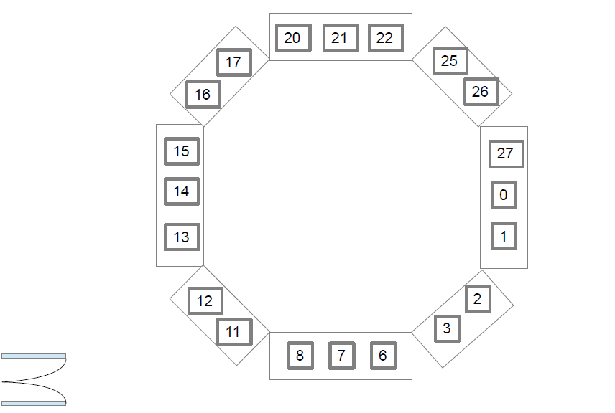
OPCC Public Performance Meeting 28.6.2019
Helen Booth
Performance Manager
Gareth Morgan
Chief Constable
Matthew Ellis (Chair)
Police and Crime Commissioner
Nick Baker
Deputy Chief Constable
Glynn Dixon
Chief Executive

