Slide 1
Public Performance Meeting February 2020 Risks, Issues and Opportunities
PCC Investment Opportunities 2019/20
Operation Uplift
HMICFRS Integrated Peel Inspection 2019

Slide 2
PCC Investment Opportunities 2019/20
5 areas developed - £1.7 million investment
Missing Person Investigations (Team)
Roads Policing Unit
Disruptions Team
Digital (Investigations) and Cyber Capability
Comms data; automatic analytics
Teams scaling up in-year
Significant capability enhancements and results

Slide 3
Missing Persons Investigation Team
Capability in place since April 2019
Team is a mixture of PC’s and police staff (supervision & researchers)
Full Evaluation conducted
Approach/investment stopped and reversed rising trend in incidents of missing people
24% Reduction in Missing Episodes - 1210 fewer cases
Also replicated where the missing person is young (under 18) 22% reduction – 731 fewer cases
22% Reduction in Missing Individuals – 548 fewer people missing
7% Reduction in time missing – the average is now less than 24hrs
Reduction in the number of repeat MISPERS, also fewer MISPERS in the higher bandings (11+) of repeated missing episodes.

Slide 4
Roads Policing Unit
The Roads Policing Unit is now firmly established with the remaining planned officers arriving at the start of February 2020. The unit has achieved some significant results since inception, these will increase significantly in the coming months once essential training is complete.
Two RPU teams are now established; providing 7 day coverage.
Off road bike capability now in place. Providing additional Tactical options to target ASB and criminal use of bikes, and provide further options to assist in searches of vulnerable people.
Pursuit resolution (TPAC), is now in place and being utilised by the team to achieve some significant results – further training on-going to provide effective capability
Drone capability of 3 (2 received, 1 awaited), training of pilots in progress (9 out of 16 complete)
Network of SPOCs across force for road safety (Op Lightning), Giving further capacity to implement the Force Harm Reduction plan and target Criminality.
New marked vehicle capability & dual-lane ANPR capability
Harm reduction officer working with safer Roads Partnership targeting accident hotspots and planning a number of harm reduction operations.
Significant success working with Disruptions Team regarding Tier 1-2 criminality

Slide 5
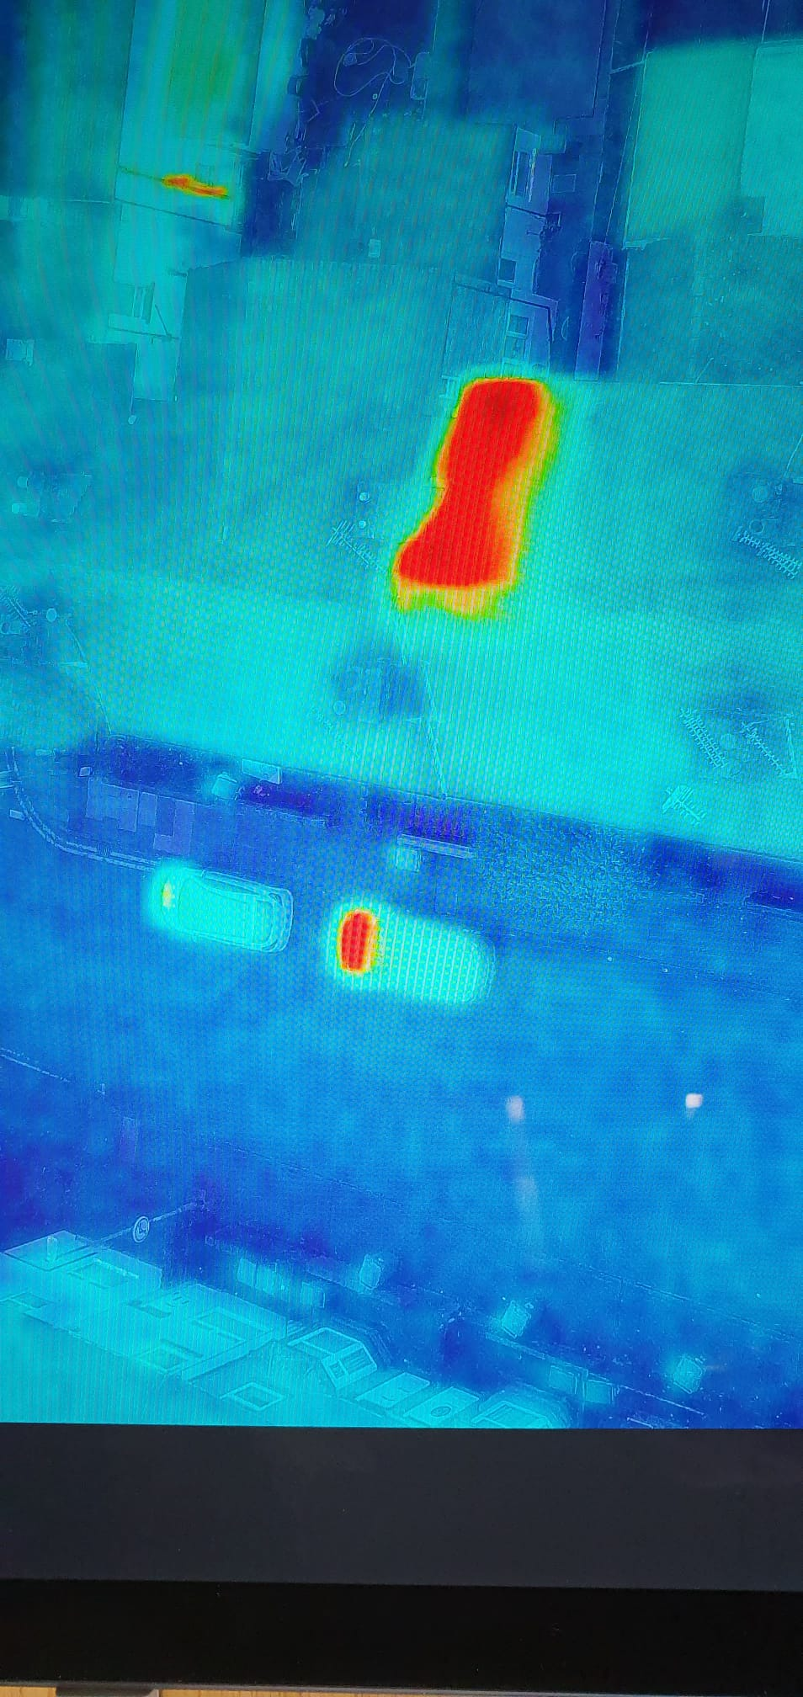
Roads Policing Unit – deployment examples
RPU – Drone Capability
The unit is proactively acting on intelligence to identify locations used in Cannabis Cultivation. A recent flyover in Stoke South utilising thermal imagining resulted in locating 2 cannabis plantations.
Deployments are taking place regularly and being utilised to locate high Risk Missing persons
RPU - Pursuit Resolution / Prevention
A key part of the upskill to TPAC is the capability to prevent pursuits from occurring. This is already being utilised regularly through planned operations in the county, preventing high risk pursuits that can result in a significant danger to the public and loss of evidence.
ANPR activation identified a stolen vehicle obtained as a result of a Robbery on the A34. Pre-emptive tactics were utilised against the vehicle that resulted in 4 significant nominals being arrested. cutting equipment, master keys, lock pickers and LBD ports all recovered.
Working with the Disruptions team has resulted in a number of significant results. TPAC was utilised in a planned capacity in order to stop a cloned BMW that was being utilised to transport Drugs across County Lines.
RPU – KSI Harm Prevention
A Harm Prevention plan has been developed and adopted by the Force. The team has a number of commitments identified buy the plan which will result in 24 operations taking place over the coming year. The intention is to reduce those who are killed or seriously injured on the roads
Operations including; targeting Driver Behaviour, Improving safety of cyclists on the road; targeting Drug and Alcohol use

Slide 6
Disruptions Team
launched 7 months ago; 2 DSgt, 8 DC/PC. Split teams evenly covering North & South.
146 arrests to date; 265 Stop checks/search
Arrests in addition to drug offences include Rape, Serious Assaults, Burglary, Modern Day Slavery (Trafficking) & Breach of Licence.
In excess of 60 ongoing Possession With Intent to Supply Drug supply investigations.
Weapons seizures including Knives (32), lump hammer, Axes, Baseball Bats, Machete’s, 1 Firearm, BB Gun, Sword
16 Safeguarding Referrals
Significant impact on: Burton Upon Trent, Burntwood, Burslem, Stoke on Trent, Cannock, Chasetown, Codsall, Lichfield, Tamworth & Uttoxeter.
Both teams are supporting numerous Force initiatives including: focus on Force priorities as per ‘Tasking’ including County Lines, Car Key Burglaries, Violent offences and illegal possession of weapons. Also responding to real time intelligence and priorities as set by the Force localities meetings.

Slide 7
Digital (Investigations) and Cyber Capability
Activity and advice right across force area
Significant impact re initial digital/cyber work with MID
CID North & South : Deployments to aggravated burglaries, serious assaults and rape, Missing person investigations and advice over tracing suspects electronically.
CPET : Operation Callory and support for Operation Safenet.
Uniform : Advice about removing posts from social media, communication applications.
Communications : Abuse on Single on line home, tracing the suspect.
Knowledge Hub : Research into potential copycat disorder at sports stores and tracing wanted individuals.
Internal and external Cyber awareness training in progress (CID, SOMU, IO’s etc.)
Including Dark Web for Staffs CC

Slide 8
Comms Data; Automatic Analytics
An analytical and intelligence solution that enables various data sets including telecommunications data, ANPR and device downloads to be cleansed, combined and analysed using maps and reports in order to generate lines of enquiry and produce evidential products - supports both analyst and investigative officer needs
Rapidly processes large volumes of raw telecommunications data
Allows overlay of different datasets (Excel based)
Reports, exports and maps can be used in court evidentially
Builds a picture of the full investigation & Improves efficiency of investigations
Saves up to 97% of Analyst’s time in data preparation
Actionable intelligence in near real time / immediate insights into data
Full disclosure of digital evidence

Slide 9
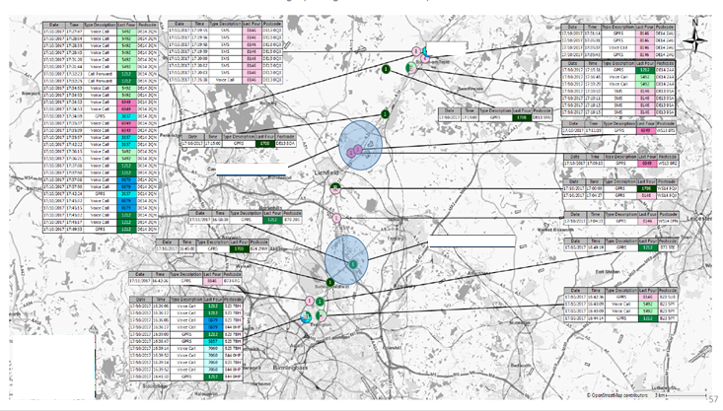
Comms Data; Automatic Analytics [Chorus] - examples
Chorus has been used in force to date to support to a variety of investigations;
[County Lines, Homicide, Stalking and Sexual Harassment,
Missing People, Kidnap, Violence/disorder, Burglary, Vehicle Crime]
Chorus analyser has been used in 35 new investigations
since November 2019
Whilst providing ongoing support to
9 Homicide investigations
46 CID investigations including missing persons
10 Local/Neighbourhood Policing investigations
8 Child Protection Investigations
Example of output from Chorus
Since Chorus has been in use by Staffordshire Police it has been used evidentially at court with Sentencing accrued to over 76 years for completed investigations to date

Slide 10
Operation Uplift – Background and Context
National increase of 20,000 police officers over 3 years
Welcomed by the Staffordshire Commissioner and the Chief Constable
Staffordshire’s anticipated allocation is 300:
90 in 2020/21 (confirmed and grant funding received)
120 in 2021/22 (estimated)
90 in 2022/23 (estimated)
Genuine increase in officer numbers above previous precept increases
Achievement of officer numbers monitored by Home Office

Slide 11
Operation Uplift - Opportunity
Uplift gives the opportunity to deploy additional officers in areas of most need as decided by the Chief Constable
Allocation of the 90 officers in 2020/21 (30 in March 2020; 60 by March 2021) is planned in the following areas:
24/7 Uniformed Proactive disruptions
Offender Management
Adult Protection Exploitation Team
Child Protection Exploitation Team
Tutoring of new constables
Roads Policing

Slide 12
PCC Investment Opportunities 2020/21
6 areas developed - £1.7 million investment
Supporting ‘Uplift’ investment; focused on proactivity, preventative activity and investigative capability
The Special Constabulary (Equipment)
Automatic Number Plate Recognition (ANPR)
Technology and Digital Capability
Technology Modernisation & Innovation
Contact Management Data Exploitation Systems
Investigations & Intelligence

Slide 13
HMICFRS Integrated PEEL Assessment Report 2019
Staffordshire Police assessed as:
‘Good’ at effectively reducing crime and keeping people safe;
‘Good’ at operating efficiently and providing sustainable services to the public;
‘Good’ at how it treats the public and its workforce with a continuing focus on upholding an ethical culture and promoting the standards of professional behaviour it expects

Slide 14
HMICFRS PEEL Inspection - Staffordshire Results Timeline

Slide 15
Risks, Issues & Opportunities
Managed at a strategic level through Force Strategy Board
Reviewed formally bi-monthly
Risks, Issues & Opportunities currently covering following areas:
Technology
Local Change
National Change

