Slide 1

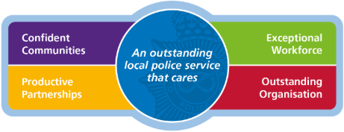
Public Performance Meeting
14 May 2026
Data to 31/03/2026
Performance Team
May 2026

Slide 2

Contents
OUR VISION:
“An outstanding local police service”
To work together to build a safe and confident Staffordshire, secured by an outstanding local police service that is passionate about serving the public, caring for its people and working in partnership.
Emerging challenges Slide
1.1 Chief Constable’s foreword and HMICFRS inspections update 3
Staffordshire priorities including National Crime and Policing Measures (NCPM)
Key Headlines 4
An outstanding local police service: local crime priorities
  3.1 Rural crime 5
  3.2 Retail crime 6
  3.3 Vehicle crime 7
  3.4 Roads policing 8-10
An outstanding local police service: public confidence and victim surveys
  4.1 Public perception surveys 11
  4.2 Improve satisfaction among victims and witnesses, with focus on victims of DA (NCPM) 12
  4.3 Local complaints, IOPC bulletins and complaint reviews (focus on organisational learning) 13-14
An outstanding local police service: contact and local policing
  5.1 Emergency and non-emergency calls 15-20
  5.2 Response: Grade 1 and Grade 2 including Enhanced Video Response 21-23
  5.3 Reduce neighbourhood crime (NCPM) 24
  5.4 Tackle anti-social behaviour 25-26
  5.5 Outcomes 27-29
Preventing and protecting: national crime performance measures
  6.1 Reduce murder and other homicide (NCPM) 30-32
  6.2 Reduce serious violence (NCPM): inc. domestic abuse and violence against women and girls 33-37
  6.3 Disrupt drugs supply and county lines (NCPM) 38-40
  6.4 Tackle cybercrime and fraud (NCPM) 41
Supporting victims
  7.1 Victims’ Code of Practice compliance 42-44
  7.2 Criminal justice – timeliness 45
An outstanding local police service: enabling services
  8.1 Workforce update: officer recruitment and diversity 46-48
  8.2 Efficiency 49
  8.3 Value for money 50
2

Slide 3
“An outstanding local police service”
1.1 Chief Constable’s Foreword
This performance document sets out the force’s performance over the last 12 months, reflecting both the complexity of modern policing and how we are achieving our commitments to you within our policing plan and the Staffordshire Commissioner for Police, Fire & Rescue and Crime Ben Adams’ Police and Crime Plan. It is pleasing to once again see an improving performance picture over this reporting period which is as a result of the hard work and dedication of our officers, staff and volunteers and their commitment to making Staffordshire safer. Over the last few months, His Majesty’s Inspectorate of Constabulary and Fire & Rescue Service (HMICFRS) has been undertaking its latest PEEL inspection of the force. Whilst it will be some time before we receive our gradings, HMICFRS has already noted some positive improvements to our performance which I look forward to seeing reflected in the report when it is published in June.
Our focus to provide a responsive service and to be there when you need us most has seen 999 performance improve over the last 12 months. We are now answering 92 per cent of 999 calls within 10 seconds. Meanwhile, our non-emergency (101) call performance is also improving – in February our average time to answer 101 calls was just over one minute.
To ensure officers attend emergencies as quickly as possible, we have recently launched two new initiatives, Operation Freshwater and Project Maximus. Both ensure we have the right resources in the right place at the right time. This work is allowing us to attend incidents more quickly, with an overall reduction in our attendance times for the most critical incidents (grade 1s) and we continue to see a reduction in attendance times for grade 2 incidents. We’re starting to see some real progress, improving how we manage incidents, strengthening our response and shifting demand in a way that better supports Staffordshire communities.
Overall crime levels have increased slightly during this reporting period, with 88,283 crimes reported in Staffordshire between April 2025 and March 2026, compared to 85,907 in the previous 12 months. We have seen particular increases in robbery (+48 per cent), drug offences (+24 per cent), possession of weapons offences (+11 per cent) and sexual offences (+11 per cent). The rise in sexual offences is partly due to improved confidence among victims in coming forward and enhanced recording practices across forces. Our dedicated team of specialist detectives focus solely on rape and serious sexual offences. They work to build strong, evidence-based cases that support victims and increase the chances of successful prosecution. Specially trained frontline officers ensure that victims receive immediate, expert support from the outset.
Whereas there have been notable decreases in theft from a person (-19 per cent) and shoplifting (-10 per cent). Some of these increases / decreases are as a result of changes to how theft, robbery and burglary offences are recorded. We have also seen a tragic increase in the number of deaths on our roads over the last 12 months with a six per cent increase. Collisions that have led to serious injuries have increased by 12 per cent compared to the previous 12 months.
Our dedicated Road Crime Team are committed to enforcement and preventative activity. The team plays a major role in tackling vehicle-related offences. In 2025, they carried out 3,744 drug and alcohol tests, arrested 1,003 people, seized 244 stolen vehicles, and recovered £16.2 million in criminal assets. The new series of Motorway Cops: Catching Britain’s Speeders on 5 features our road crime team officers showcasing the fast-paced, challenging and often unpredictable work they do every day to keep Staffordshire’s roads safe.
As you may be aware, the government published a white paper on police reform earlier this year. The proposals include significantly reducing the number of police forces in England and Wales, by merging existing forces into larger regional police forces. The government does not propose what the new geographies of these larger forces will be. Instead, it has set up an independent review that will consider the best way to organise regional police forces. This should report in the summer of 2026. However, change on this scale will not happen overnight and it will take a long time to implement everything proposed.
Police reform will also be taking place against the backdrop of very significant changes in local government across England. With police reform, English devolution plus local government reorganisation all occurring at the same time, the critical importance of policing and public safety remains at the forefront of decision making to ensure we continue to do all we can to keep our communities safe. The government also announced, at the end of last year, that police and crime commissioners will be abolished by May 2028, at the end of their current term. Their responsibilities will be transferred to elected mayors or new local Policing and Crime Boards. Through close working with local authorities and other partners, the Staffordshire Commissioner aims to deliver a seamless transition to the new arrangements in 2028.
3

Slide 4







“An outstanding local police service”
2. Key Headlines
Staffordshire priorities including National Beating Crime Measures (NCPM)
Key
Prevent harm and protect people
Statistics from 01/04/2025 to 31/03/2026
Percentage shows change with previous year
All crime in Staffordshire
Sexual offences
88,238 | 85,907 | 78,851
4,249 | 3,828 | 2,948
Statistics from 01/04/2024 to 31/03/2025 (previous year)
3%
11%
Statistics from 2019/2020 baseline or National baseline for crime of calendar year 2019
Baseline 2019/2020 Validated crime
Prevent harm and protect people – National Beating Crime Plan
Reduce offending and reoffending
More effective criminal justice system
Neighbourhood crime
Knife crime
Domestic abuse (crime)
Criminal justice outcome Rate
Charge & postal requisition rate
8,316 | 8,602 | 9,442
757 | 758 | 530
18,349 | 17,676 | 15,102
16.5% | 15.7% | 13.4%
10.9% | 10.3% | 9.2%
0%
4%
0.8%
0.6%
-3%
Baseline 2019/2020
National baseline (2019) – Validated crime
Support victims and witnesses
Enabling Services
Local and responsive service
999 calls
(emergency demand)
Non-emergency demand
(101 calls and digital contact)
Anti-social
behaviour
Positive opinion after contact with the police
Public confidence in the police
Officer uplift (number of officers)
71.8% | 69.1%
64% | 61%
2,071 | 2,018 | 1,700
205,794 | 204,361 | 184,158
345,375 | 352,886 | 335,601
18,014 | 15,099 | 31,094
3%
3%
3%
0%
-2%
19%
Previous Year Apr 24 to Mar 25
CSEW Survey in Sep 2025 vs Sept 2024
Baseline 2019/2020
4
Baseline 2019/2020
Notes:
Headlines - % change shows the comparison with previous year.

Slide 5
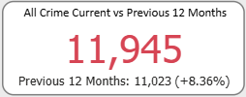
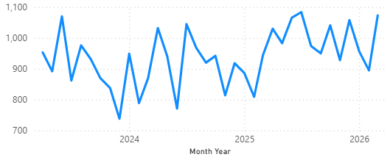
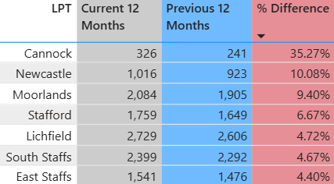
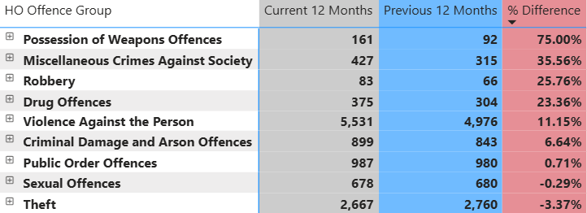
3. Local Crime Priorities
3.1 Rural crime
“An outstanding local police service”
Rural communities are the backbone of our county. They are places where people work hard, support one another, and contribute immensely to our way of life. It is, therefore, essential that everyone in our rural areas feels safe and secure. Unfortunately, rural crime poses unique challenges to our communities. From theft and burglary to wildlife crime and organised criminal activity, these offences can have a devastating impact on individuals, businesses, and the environment. This is why, as a force which is 70 per cent rural, we have developed a revised approach to how we tackle rural crime, protecting communities and bring offenders to justice through a dedicated proactive team, having additional officers trained to support rural crime prevention and working with partners to understand and combat the causes of crime in rural communities. Staffordshire also has over 8,000 sites identified as heritage locations and over the next 12 months we are working to develop a stronger response to identify and investigate heritage crime, with staff being trained by Heritage England to be specialist heritage crime investigators.
Rural Crime
Any crime committed in a rural location where the victim is specifically targeted because of their connection to or involvement in the rural community, economy or area.
DEFINITION
County Proactive and Rural Crime Team
The team supports local policing teams with their identified risks and assist with the implementation of problem-solving interventions, safeguarding tactics, intelligence development and assessing vulnerability across the county. In the last 12 months, the CPART team has had a positive outcome rate of 51.9 per cent.
Volume of crime in rural neighbourhoods
Rural crime
11,945
There has been an investment in technology that has helped provide a more defined methodology for the identification of rural areas since the last public meeting.
5
Notes:
Power BI dashboard is now based on more advanced identification of rural areas based on polygon mapping.

Slide 6
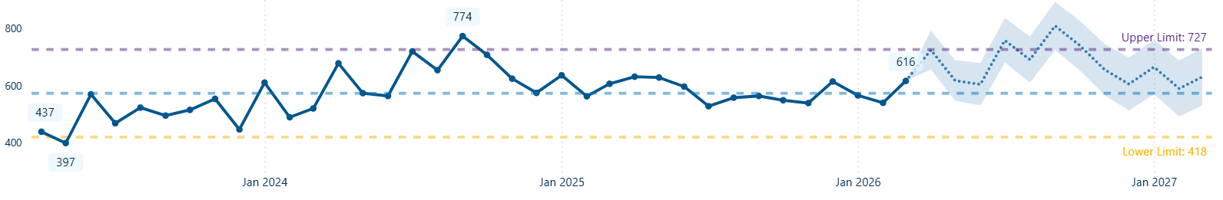
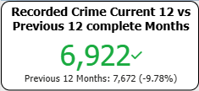
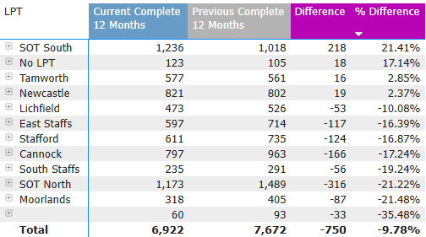
3.2 Retail Crime
“An outstanding local police service”
We have seen some fantastic work through the summer period that has resulted in shoplifting and business robbery experiencing reductions throughout the period. The results have been achieved through:
1) Our commitment to visible policing in town centres during the winter period into spring – particularly in places of high commercial footfall, ensuring that local police officers and police community support officers are on foot in town centre areas every day.
2) Hosting events with over 364 relating specifically to business crime which was well received by over 2,255 engaging participants in the last 12 months.
3) Our commitment to problem solving ensuring that:
· We increase our focus on high volume repeat offenders
· Take a ‘right first time’ approach to offenders and outstanding suspects
· Work with victims to design out crime.
4) Signing businesses up to the Safer Places Charter, with over 100 business across Staffordshire signing up to support us in our commitment to preventing VAWG.
Each local policing team has a business crime SPOC who assists in coordinating events and leading on initiatives.
Shoplifting Crimes
6,922
Shoplifting crimes have decreased, with a 9.8 per cent decrease (-750) in the last 12 months compared to the previous 12 months.
Outcomes:
In the last 12 months, 30.4 per cent (2,262) of shoplifting crimes had a criminal justice outcome. The majority of these are charges (1,709). The CJ outcome rate has increased by 1.4 per cent compared to the previous 12 months.
In the last 12 months, the majority 42.8 per cent (3,186) of shoplifting crimes were Investigation completed – no suspect identified, and there was a 6.1 per cent increase compared to the previous 12 months.
These were the only increases seen and while many outcomes remained stable. Victim declines/withdraws support to action to identify offender saw a decrease of 4.3 per cent compared to the previous 12 months.
Safer Business Action Week (10 November 2025) involved higher footfall in town centre and retail heavy areas with a focus on education and prevention working with local retailers.
The winter intensification period saw a number of arrests, engagement activities resulting in the reduction in shoplifting we have seen since the beginning of 2026.
Data is for the last 12-month period to the end of September 2025
Shoplifting – Second of eight in MSF and 9th of 42 forces. Nationally (6.31 per 1,000 population)
Business robbery – fourth of eight in MSF and 23rd of 42 forces nationally (0.23 per 1,000 population)
Business burglary – fifth of eight in MSF and 18th of 42 forces nationally (0.97 per 1,000 population).
National Comparison
Partnership Against Business Crime in Staffordshire (PABCIS) works closely with our problem-solving officers to highlight offenders, good practise and prevent offences.
6
Notes:
National Comparison from Iquanta

Slide 7
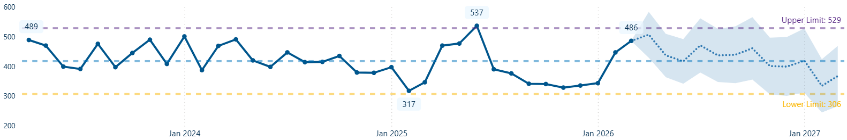
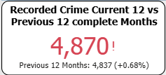
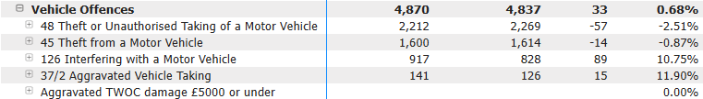
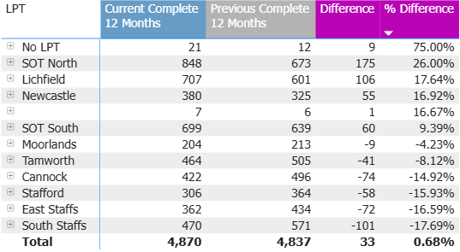
3.3 Vehicle Crime
“An outstanding local police service”
Vehicle Crimes
Data is for the last 12-month period to the end of September 2025
All vehicle offences - fifth of eight MSF and 27th of 42 forces nationally (4.25 per 1,000 population)
Theft of motor vehicles- seventh of eight MSF and 35th of 42 forces nationally (2.02 per 1,000 population).
Theft from motor vehicles – second of eight MSF and 13th of 42 forces nationally (1.44 per 1,000 population)
For vehicle interference, sixth of eight MSF and 31^{tst} of 42 forces nationally (0.79 per 1,000 population).
4,870
Home Office Offence Groups Level 3 & 4
National Comparison
Outcomes:
In the last 12 months, 5.2 per cent (262) of vehicle crimes had a criminal justice outcome. The majority of these are charges (168). The criminal justice outcome rate decreased slightly (-0.6 per cent) compared to the previous 12 months.
For theft of motor vehicles, 5.4 per cent (126) had a criminal justice outcome. This has decreased by 1.3 per cent compared to the previous 12 months
For theft from motor vehicles, 3.7 per cent (60) had a criminal justice outcome. This has remained stable compared to the previous 12 months
For vehicle interference, 4.5 per cent (41) had a criminal justice outcome. This has remained stable compared to the previous 12 months.
In the last 12 months, the majority 73.1 per cent (3,652) of vehicle crimes were classed as investigation completed – no suspect identified, and this has remained stable (-72) compared to the previous 12 months.
7

Slide 8
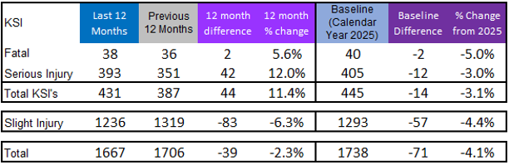
3.4 Roads Policing - KSI
“An outstanding local police service”
The Road Crime Team (RCT), introduced in October 2024, is working more closely with local policing teams addressing the concerns of residents in the communities. This includes targeting areas of criminality and a focus on initiatives to make Staffordshire roads safer places to be, concentrating on education and enforcement around speed, mobile phone, drink/drug driving and seat belt offences (fatal 4). It also focuses on more targeted offences around weight restrictions and insecure loads of good vehicles and tachograph offences. The team are also committed to delivering the Bike Safe programme to educate motorcycle riders and enhance their skills. They also support Community Speedwatch. The RCT has undertaken professional accreditation and meet the national profile and standard for roads policing officers.
Killed and serious injury (KSI) road traffic collisions have increased by 11.4 per cent (+44) compared to the previous year and have reduced by 3.1 per cent (-14) in the last 12 months compared to the 2025 baseline. The number of fatal collisions has increased with a degree of variance month-on-month and high volumes in a particular month will have a significant impact on the yearly comparison.
Increase in fatal collisions in the last 12 months to 38 collisions (increase of two), with 38 fatal casualties, this includes a number of possible deaths at the wheel/natural causes (awaiting inquest results)
There is a large variance of fatal collisions when viewed month by month but over recent months the number of fatal collisions appears to have stabilised
8
Notes:
Note there can be more casualties than collisions.

Slide 9
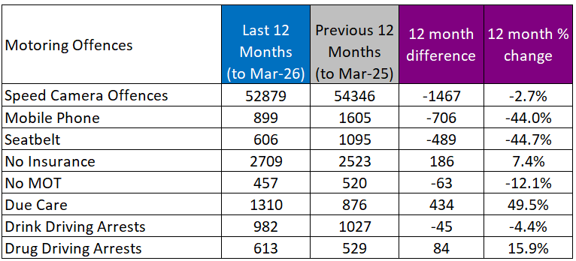
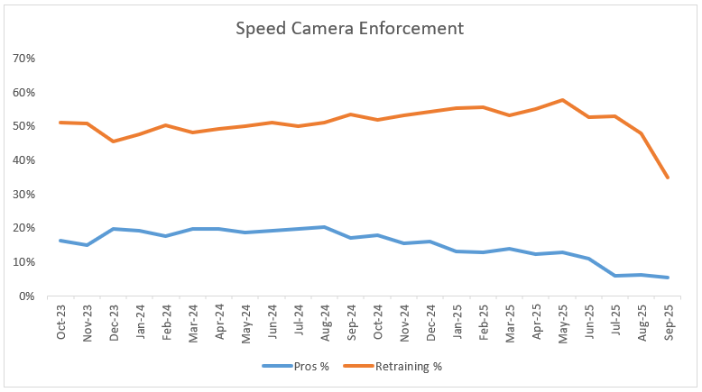
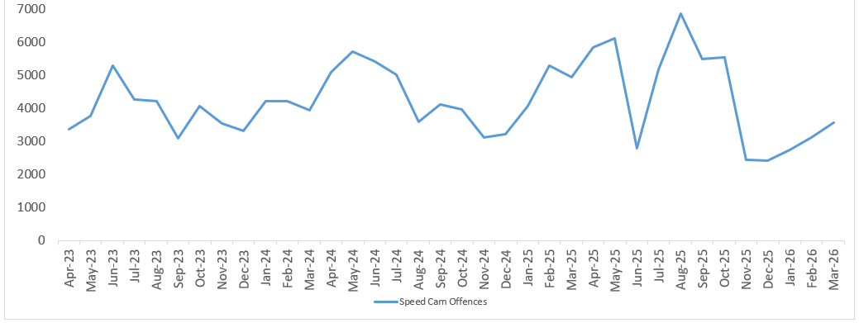
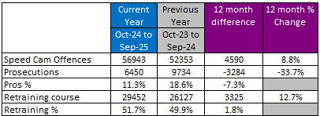
3.4 Roads Policing – Motoring Offences
“An outstanding local police service”
In the last 12 months (October 24 to September 25), tickets have been issued for offences relating to driving documents, manner of driving or condition of the vehicle.
Three per cent decrease in speed camera offences in the last 12 months. This is related to lower activity in recent months due to decreased resource availability and enforcement direction from National Highways
Reduction speed camera offences in June 2025 due to some issues in the availability of technology due to a system upgrade
Significant increase of due care offences.
Speed camera offences
Speed Camera Offences Enforcement
Data in relation to speed camera ticket disposals can only be reported on for the period up to six months prior to the data for offences. This is to allow for offenders to book and complete a retraining course if desired. Prosecutions are of those who fail to attend and complete a retraining course or elect for the matter to heard at court. Therefore, the disposal data shows the period October 24 to September 25.
9

Slide 10
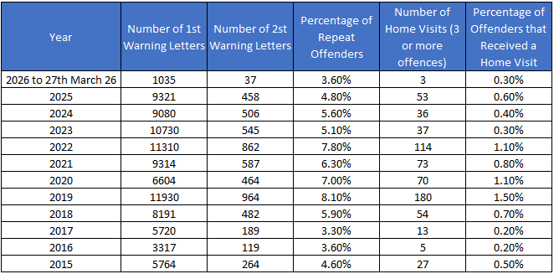
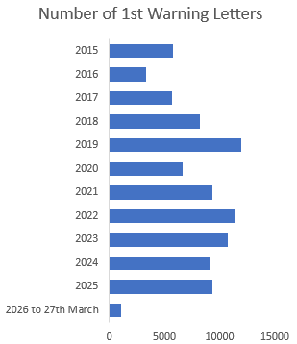
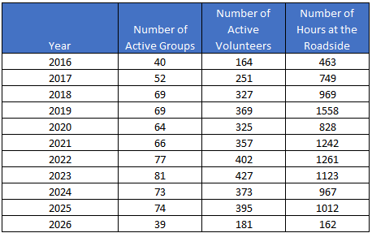
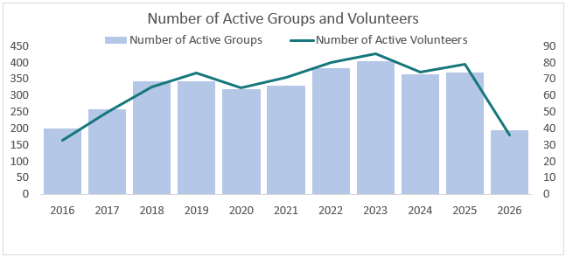
3.4 Roads Policing – Community Speedwatch
“An outstanding local police service”
1st January 2026 to 27th March 2026
Total number of monitoring sessions | 177
Total hours of monitoring | 162 hours
Outcomes of Activity
Volunteer Overview / Activity
Ongoing projects:
Instead of making Community Speedwatch bigger (growth of groups/volunteers) the plan is to make it better, and by doing so growth will follow.
We can achieve this by:
Increasing the links with PCSOs to strengthen community engagement within policing
Promote the use of volunteers in policing through Corporate Communications
Further strengthen partnership working and good practice with neighbouring forces who operate Community Speedwatch
Involve Community Speedwatch in more road safety operations with local policing teams, the Road Crime Team and the Safety Camera Team.
2026 shows Jan-Mar 26
10

Slide 11
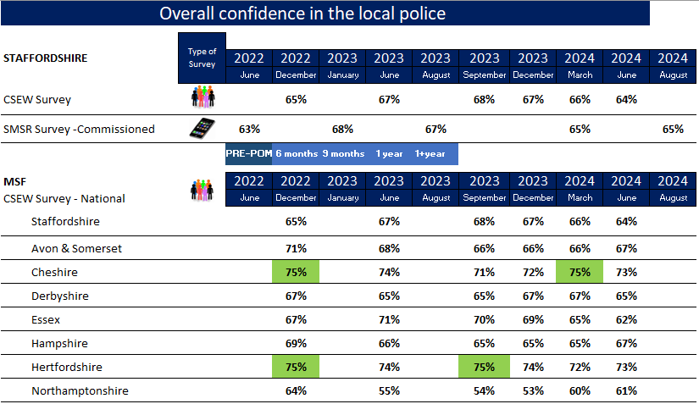
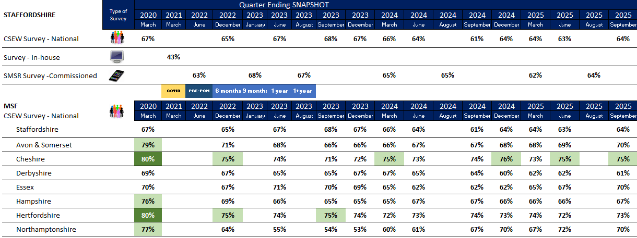
4 Public Confidence and Victim Surveys
4.1 Public perception surveys
“An outstanding local police service”
Overall public confidence from Crime Survey England and Wales (CSEW) is at 64 per cent in September 2025. This has increased slightly compared to June 2025 (the latest previously published CSEW results)
The telephone survey results for August 2025 showed consistent public confidence levels of 64 per cent
Perception of ASB is consistently an area of low confidence –Staffordshire was 39 out of 42 forces nationally (previously 41) and eight out of eight forces comparing MSF (previously 8) in September 2025
Public confidence is a key indicator of an effective and legitimate police service. In Staffordshire, public confidence in policing is measured using a combination of national data, local insight, and independent inspection to build a comprehensive understanding of how communities experience and perceive Staffordshire Police.
One of the primary sources of public confidence data is the Crime Survey for England and Wales (CSEW). This national survey captures public perceptions of policing alongside experiences of crime, fear of crime, and victim satisfaction. It includes questions on whether people believe the police are doing a good job in their local area, treat people fairly, and can be relied upon when needed. Staffordshire’s results are monitored over time and compared with regional and national benchmarks to identify trends and areas for improvement.
We also gather local confidence data through force-wide and neighbourhood-level surveys. Local surveys provide more detailed insight into community priorities, feelings of safety, visibility of officers, and satisfaction with recent police contact. We have recently commissioned a company called Zencity to obtain digital community feedback about our service from people that live in Staffordshire.
11
Notes:
CSEW - Not as high as was in 2019 (75%) – fairly static last 6 surveys hovering around 61-65% for both CSEW and SMSR
This data is from people who have not necessarily had with contact police

Slide 12
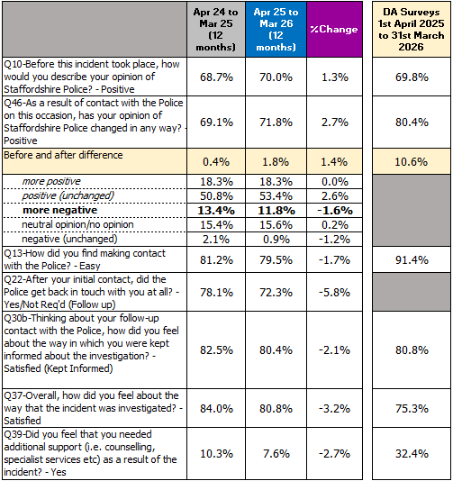
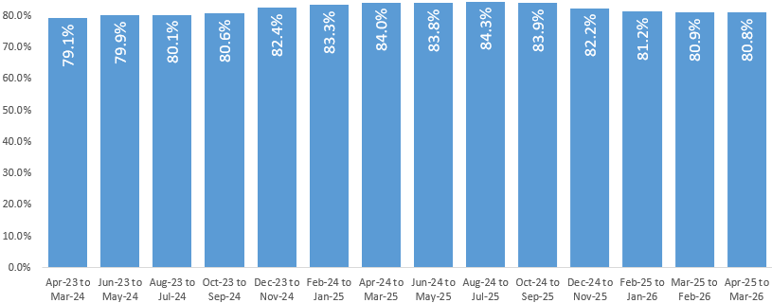
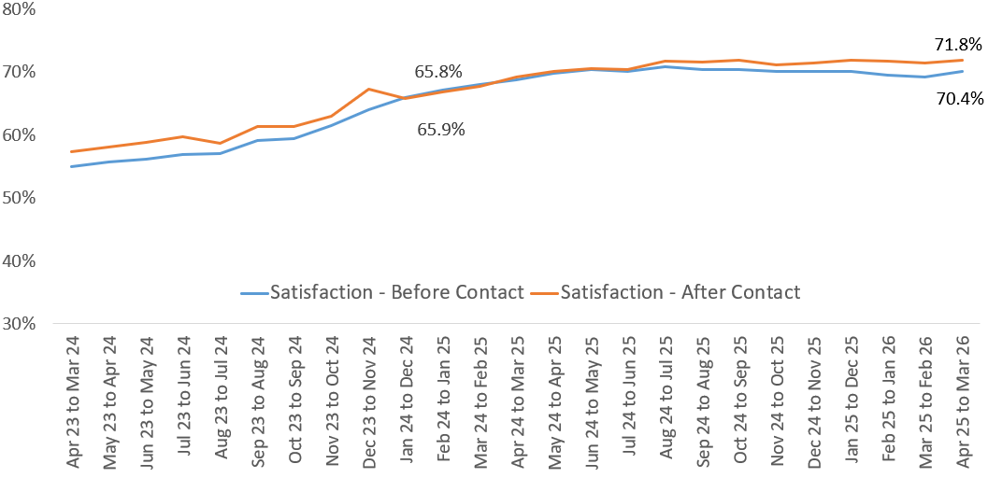
4.2 Improve Satisfaction among Victims
“An outstanding local police service”
Nationally, this will most likely be measured through the Crime Survey England and Wales. The force measures victim satisfaction through a locally designed survey and on a rolling 12-month basis. The surveys are based on victims of certain crime types. The force works closely with the OPFCC to identify potential changes or opportunities for bespoke or specific surveys.
Gradual increase in positive opinions before police contact.
Positive opinions after police contact are increasing in line with satisfaction before contact.
Initial contact remains stable at 79.5 per cent
Kept informed has increased in the last two years up to 80.4 per cent.
Decrease in the satisfaction with the investigation (-3.2 per cent) compared to the previous year. This has been stable and has maintained a rate above 80 per cent since July 24.
People needing additional support has reduced (-2.7%).
Satisfaction with investigation (rolling 12 months)
Satisfaction before and after contact with police
Focus on victims of domestic abuse: We began surveying of victims of domestic abuse in April 2024 to develop and improve the service that victims of this crime type receive.
Currently only a small volume of surveys have been completed (437 in the last 12 months compared to over 4,700 general victim of crime surveys)
Key questions from the crime survey were retained in all surveys to assist with analysis
The survey was introduced in June 2024 to understand our service to victims od domestic abuse and assist with compliance with a statutory national return
Satisfaction after contact with police is better for victims of domestic abuse surveyed compared to the general victims of crime survey at 76.5 per cent. Satisfaction with initial contact is also better for victims of domestic abuse surveyed compared to the general victims of crime survey at 91.4 per cent.
12
Notes:
New data for DA surveys now added in.

Slide 13
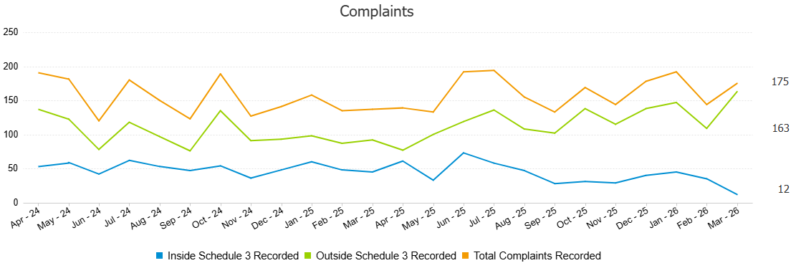
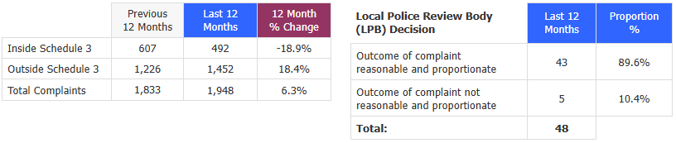
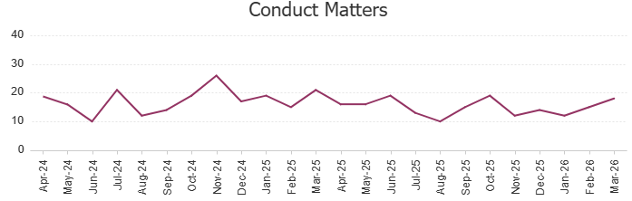
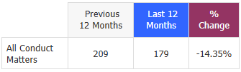
4.3 Local Complaints, reviews and IOPC bulletins
“An outstanding local police service”
Complaints are described as Inside or Outside Schedule 3:
Inside Schedule 3 is a recorded complaint or investigation, with a right to review to the local policing body or the IOPC.
Outside Schedule 3 is a logged complaint. The allegation if proven must not justify misconduct proceedings and there is no Right to Review.
DEFINITION
Triage
PSD have triaged 73.6 per cent of all complaints (1,417) in the last 12 months.
In March 2026, PSD triaged 88.1 per cent of all complaints (104).
Lessons Learned
In the last 12 months, LPB decisions led to 11 lessons learnt, while conduct matters led to 64, predominantly through learning by reflection and reflective practice.
There are 160 complaints (inside schedule 3) that are currently being processed. Once processed this will put the last 12 months figures in line with the previous 12 months.
13

Slide 14
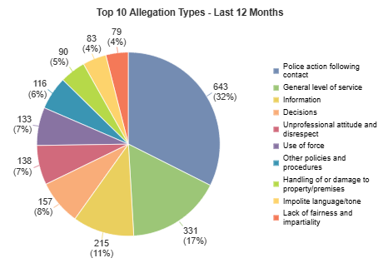
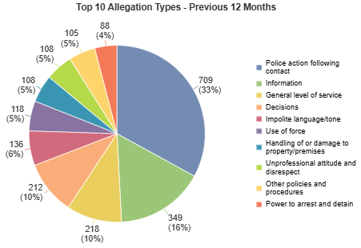
4.3 Local Complaints, reviews & IOPC bulletins
“An outstanding local police service”
The Professional Standards Department (PSD) continues to have predicted increases in dissatisfaction reporting, predominantly at a lower level including the key themes of police action following contact and information provision. Following the successful introduction of the triage process to give timely reparation around low-level response, triage in March processed 88 per cent of all demand into PSD. This statistic is influenced by demand awaiting allocation, within the initial evidence-gathering phase and awaiting administrative finalisation. We anticipate performance will stabilise around 70 per cent, demonstrated by the annual figure of 73 per cent to date. The success of the triage process is instrumental in retaining ownership of 99 per cent of all dissatisfaction within PSD and enabling front-line staff to continue to respond to the public. This performance is being maintained in the face of five per cent per year rising demand.
Conduct matters are robustly managed and investigated. Outcomes of meetings and hearings are reported on to ensure the force educates and re-enforces the standards of professional behaviour expected of our staff. ‘Know the Line’ training continues across the force, and includes abuse of position for sexual purposes, a significant corruption threat facing policing. Staffordshire Police continues to robustly investigate sexual misconduct, and we are doing all we can to educate officers and staff and encourage reporting. A force-wide action plan involving a range of stakeholders has been developed and ongoing activity continues, to reduce and prevent future offending. Recent misconduct hearings, highlighted in the media, demonstrate how these types of behaviours will not be tolerated.
Independent Office for Police Conduct (IOPC) statistics evidence that Staffordshire is performing better than the national average around timeliness for complaint handling and response to the public.
A quarterly IOPC report year to date (1 April 2025 to 31 December 2025) found that Staffordshire referred 61 cases through to the IOPC which has reduced from the same period last year (68) and is lower than our most similar forces, who averaged 104.
The force proactively scan incidents which are linked to any deaths or serious injury following contact with the police and refer these to the IOPC to ensure transparency.
Of these referrals, one was independently investigated (by the IOPC), 36 were local investigations (conducted by Staffordshire Police and the final report sent to IOPC and any complaint if applicable), three were deemed as no investigation necessary by the IOPC and 21 were returned to the force.
Top three allegation types in the last 12 months: police action following contact (32 per cent), general level of service (17 per cent) and information (11 per cent). These are the same top three allegation types as the previous 12 months.
14
Notes:
Complaints are mostly about police action following contact, information and decisions.

Slide 15
“An outstanding local police service”
5. Contact and Local Policing
Force contact covers telephony, digital contact, triage, front counters, contact managers, as well as support in training and contact systems administration. They handle incoming calls, digital contacts, crime and incidents reported via the force’s website and an ‘online’ chat service ‘live chat’. The force manages its contact services via our Force Contact Centre (FCC).
These contacts are classified as emergency, non-emergency, general enquiries and outgoing calls. Contact is also received from other partners and agencies such as ambulance and fire and rescue services.
Quality - HMICFRS’ last inspection found that the force had considerably improved the frequency and quality of its risk assessment process called THRIVE. Consistent THRIVE assessments are monitored through a performance system broken down by teams and individuals. This is supported by a quality and assurance team to remove the risk of positivity bias from the FCC staff reviewing the work of their colleagues. This greater understanding has promoted the improvement HMICFRS saw on last inspection where they observed THRIVE assessments of significant depth, understanding and quality.
Recruitment - There has been a comprehensive review of our recruitment and retention processes, leading to substantial enhancements in our approach. These improvements are expected to drive improved outcomes as new joiners are onboarded into Staffordshire FCC and undergo formal training and tutorship. The expected timeline for when the uplift impact will be felt is anticipated during quarter four of the financial year.
Strategic IT roadmap- In 2024, Staffordshire Police asked consultants to join the Force Control Centre to create a two-year technical roadmap focusing on resiliency, Smart STORM (our call centre system) transformation, Salesforce implementation of victim’s journeys and citizen portal, customer relationship management (CRM) and disaster recovery (DR) / business continuity management (BCM). Salesforce Phase 1 has been delivered, a secondary BCM will be delivered at Burton in Q3 2026 followed by a secondary integrated command and control solution (ICCS) in Q1 of 2027. Storm has been through 17 upgrades now working on the most up to date version in readiness for the Smart STORM upgrade in Q2 of 2027.
The Queue Buster initiative is a service providing additional accessibility by reducing frustration at the point of contact. By actively managing call queues and offering timely alternative pathways or call‑backs, it has improved reassurance for members of the public who might otherwise disengage. The initiative has also provided valuable operational insight into peak demand, call behaviours, and pressure points within the contact service, supporting more informed decision‑making. While Queue Buster does not remove the underlying demand‑versus‑capacity challenge, it represents a proportionate, low‑cost intervention that improves public experience, demonstrates accountability, and supports a more responsive and modern approach to managing contact demand.
What we are doing in the Force Contact Centre
Improving performance – Just over 12 months ago, we launched our new digital service, the Victim’s Portal. The service offers victims 24/7 access to a portal via the Staffordshire Police website, that provides all necessary details about open cases they have and gives them the ability to supply additional information. It enhances the service we give to victims of crime in Staffordshire, by offering two-way communication between the officer in the case (OIC) and victims and supports the Victims’ Code rights. The first phase of the launch looks specifically at volume crimes in these categories; vehicle crime, burglary and criminal damage.
We are in the process of onboarding a new Salesforce LiveChat onto the Salesforce Platform with Agentic AI known as ‘Bobbi’ this will bring greater consistency and efficiencies with Bobbi being able to deal with up to 72 per cent of all enquiries, this will also be deployed into the force website’s ‘Contact us’ forms.
Your Voice Matters has delivered benefits in public confidence and organisational learning. By proactively contacting callers who abandon 101, the pilot has reduced frustration, improved reassurance, and demonstrated visible accountability in direct response to known concerns about our contact service. Importantly, it has provided insight we have not previously had, helping us better understand why the public contacts us, where pain points exist, and how demand and behaviour are changing. While it does not resolve the underlying capacity pressures within the system, it represents a low‑cost, evidence‑based approach to listening to the public, improving perception, and informing more sustainable, technology‑enabled improvements going forward.
15

Slide 16
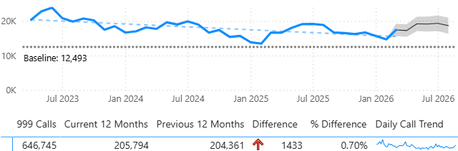
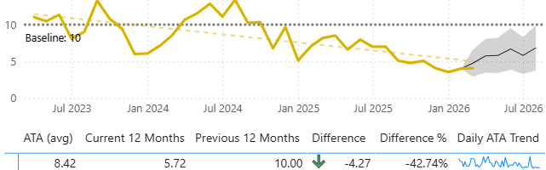
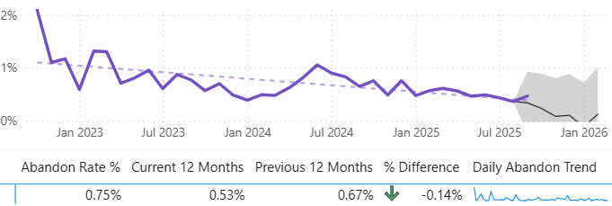
“An outstanding local police service”
5. Contact and Local Policing
5.1 Emergency Calls
Average time to answer (seconds)
Volume of 999 calls
v
Volumes of 999 calls are stable compared to the previous year.
Average time to answer 999 calls has reduced by 43 per cent compared to the previous 12 months and the last 12 months had average times to answer all under 10 seconds.
Abandonment rate for 999 calls
Data is for the last 12-month period to the end of February 2026
Nationally, the data for average time to answer and percentage of calls answered within 10 seconds is based on data from BT which is available on police.uk.
For volume of 999 calls the last 12 months Staffordshire is 25th out of 42 forces with 202,089 calls (to end of February 2026) and 5th out of 8 most similar forces. This has increased by 901 calls or 0.4 per cent compared to the previous 12 months.
Average time to answer in seconds for 999 calls is 8.83 seconds in the 12 months to February 26, which is 35th out of 42 forces and 7th out of 8 most similar forces. This has improved by 3.9 seconds compared to the previous 12 months.
88.2 per cent of 999 calls were answered in under 10 secs in the last 12 months to February 26, and Staffordshire was 37th out of 42 forces and 7th out of 8 most similar forces. This has improved by three per cent compared to the previous 12 months.
National 999 Data
Proportion of 999 calls answered within 10 seconds is 89.7 per cent in the last 12 months and has been stable since November 2022.
Good and stable performance with the 999 abandon rate remaining stable at one per cent or less since January 2023.
16

Slide 17
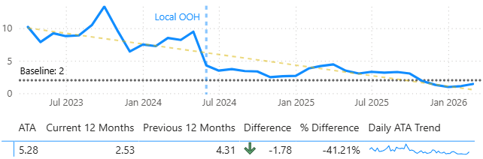
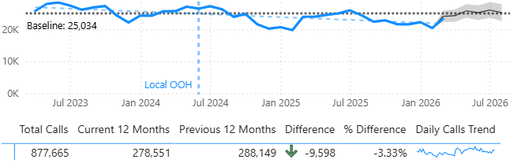


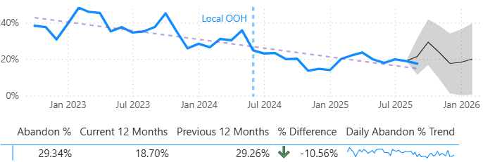
“An outstanding local police service”
5.1 Non-Emergency Calls
(First point of Contact)
Average time to answer (minutes)
Volume of non-emergency calls
The volume of non-emergency calls have reduced by three per cent and is predicted to continue to follow the usual seasonal pattern.
Abandonment rate for non-emergency calls
Reducing trend in average time to answer. Since May 2025, the average time to answer reduced to less than four minutes and has been under two minutes for the last six months. Stable trend in median time to answer since December 2023. Since May 2025, the median time to answer is less than a minute and has reduced further to two seconds for the last five months. The proportion of non-emergency calls answered within two minutes has increased to 64.5 per cent in the last 12 months and has seen over 75 per cent in the last three months.
Abandonment rate for non-emergency calls previously only included those calls passed through triage. However, the new measure includes all non-emergency abandonment (triage, Local out of hours and 101.
The proportion of all non-emergency calls answered by triage is 79 per cent in last 12 months. Approximately 43 per cent of triage calls were resolved in the last 12 months.
Abandon rate in the last 12 months is 20 per cent. This has been under 20 per cent for the last five months.
17

Slide 18
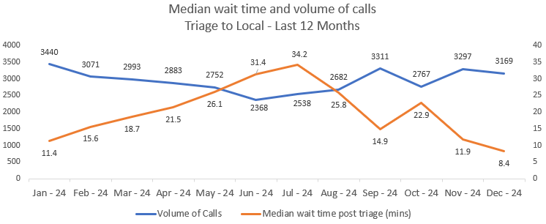
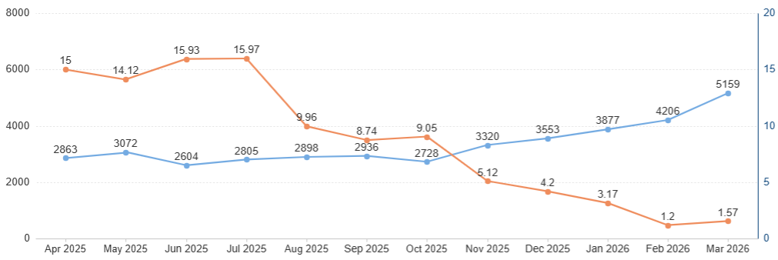
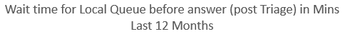
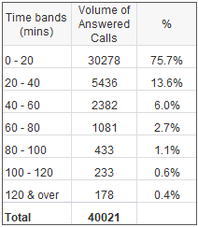
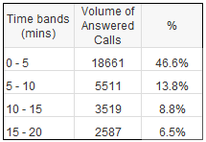
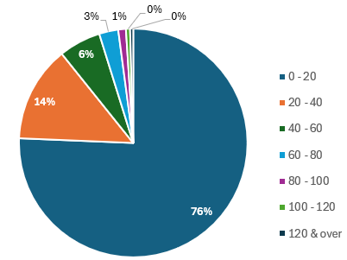
5.1 Non-Emergency Calls – Post Triage
“An outstanding local police service”
When a triage call taker decides that the caller needs to speak to an operator with specialist training, the call is transferred to a separate queue. These callers then wait for an available call taker to pick up their call. These call takers also answer emergency (999) calls. In times of peak demand, these 999 calls are prioritised over non- emergency calls. This can lead to increased wait times between speaking to triage and waiting for an available call taker. Thirty-three per cent of callers choose not to wait to speak to a local call taker and hang up. Seventy-six per cent of these are within the first 20 minutes of waiting.
The majority (76 per cent) of callers who are transferred from triage to the local queue for further assistance, spend less than 20 minutes waiting for their call to be answered, and 47 per cent are answered within five minutes.
18

Slide 19
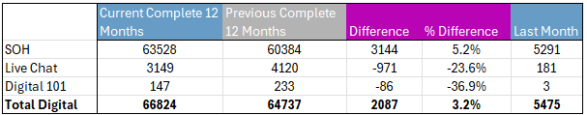
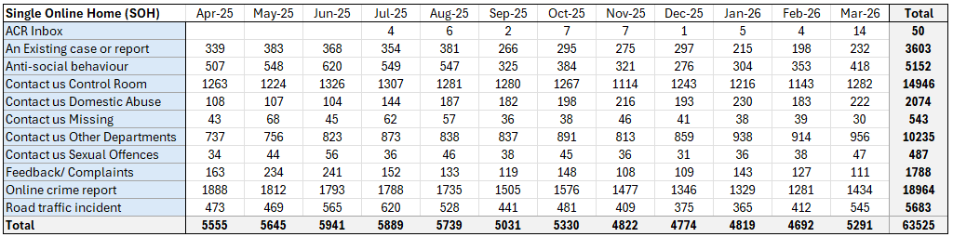
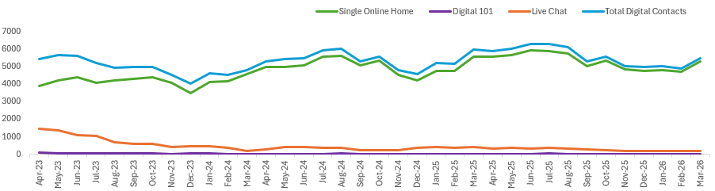
5.1 Non-Emergency Calls (Digital)
“An outstanding local police service”
Digital Contacts - Data to end March 2026
In the last 12 months, digital contacts were made up of:
Our website (95 per cent)
Live Chat on our website (5 per cent).
The table shows the different types of forms on our website. In addition to these, there is also an option for live chat.
They are either sent to the contact centre or to other departments within the force. This includes domestic abuse, missing persons and sexual offences which are dealt with by the contact centre (34 per cent) online crime reports, anti-social behaviour and road traffic collisions which are dealt with by the Investigation Bureau (44 per cent) and firearms, FOI, information rights service, and your area are looked at by other departments across the force (16 per cent).
Since early 2023, the majority of digital contact with Staffordshire Police is via the force website through single online home. Contact can also be made via police.uk.
Volume of digital contacts over time
19

Slide 20
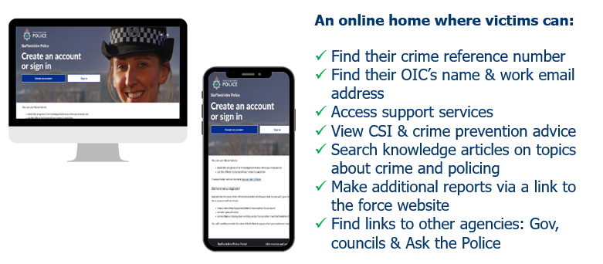
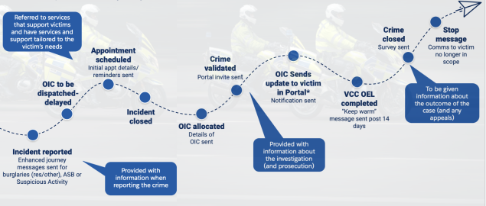
5.1 Victims Portal
“An outstanding local police service”
This service is the first in a number of improvements being made in our contact centre to give our staff and officers the right tools to do their job to provide an outstanding service to victims – one of our key force priorities.
The ‘Victim’s Journey’ sends messages to a victim of crime for specific crime types – burglary residential, vehicle crimes, criminal damage, fraud, malicious communications, suspicious incident, community nuisance, environmental crime including fly tipping.
This will help to keep the victim informed all the way through their journey with us. Burglary, vehicle crime and criminal damage have been launched first.
Victim’s Journey and Portal Flow
So far since the launch of the victim's portal (phase 1) in December 2024, there have been 90,592 automated initial updates sent to victims via text message or email.
The service sends additional information to victims of burglary and anti-social behaviour. It sends reminders for appointments booked and updates around resourcing of incidents.
There have been 8,849 messages sent to victims of burglary and 9,869 messages sent to victims of anti-social behaviour.
There have been 11,613 surveys sent to victims via text message or email when crimes/incidents have been closed.
Twenty-two per cent of victims choose to utilise the Victim’s Portal to track, monitor and keep updated about the progress of their crime/incident, they can utilise this service to contact the officer in the case (OIC). This has been used by victims 1,566 times since go-live.
Survey sent
Automated initial update
Crime information update
20

Slide 21
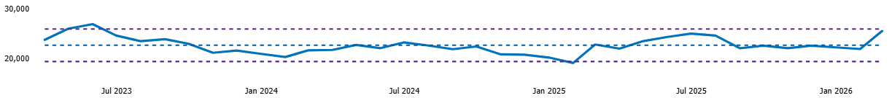





Context – Incidents
“An outstanding local police service”
Volume of incidents
All Incidents
Grade 1 – Immediate (attendance in 20 mins)
Grade 2 – Priority (attendance in 2 hours)
Grade 3 - Scheduled
Investigation Bureau – desk-based investigation
Other includes telephone resolved, CID, and police generated.
Resourced Incidents
DEFINITION
21

Slide 22





5.2 Response: Grade 1
“An outstanding local police service”
Last 12 months
Please note the axes are zoomed in to show the small amounts of variation each month
22

Slide 23



5.2 Response: Grade 2
“An outstanding local police service”
Significant activity undertaken in the last 12 months to improve Grade 2 response, which is now showing sustained improvement.
G2
All geographical LPT areas have seen median G2 response times under two hours for the last 12 months.
Domestic Grade 2 incidents take longer to attend due to requirement to send double crewed officers.
Enhanced Video Response (EVR) 2,479 incidents have been considered for EVR between 27/11/2024 and 03/04/2026. 34 per cent (844) resulted in an enhanced video response. 20 per cent (168) of those were received as Grade 2’s and 32 per cent (270) of those that received an EVR were High Risk.
23

Slide 24





5.3 Reducing Neighbourhood Crime
“An outstanding local police service”
Attendance at burglary (home) incidents is 93 per cent in the last 12 months. Further reviews continue to support all home burglaries have been attended. However, when the incident is closed prior to the attendance, the time arrived (TA) is not captured in the data.
The definition for neighbourhood crime derives from the National Beating Crime Plan
Neighbourhood crime includes:
Burglary residential
Personal robbery
Theft from vehicles
Theft of vehicles
Vehicle interference
Theft from a person.
DEFINITION
Home Office Offence Groups Level 2 and 3
Neighbourhood Crime (DCPP definition)
Visible neighbourhood policing is key to modern policing: we need all our communities to have trust and confidence in what we do, as when this is the case, communities engage more, support us more, and together help us tackle crime. Being visible in the heart of our communities remains key. We focus our patrols on known hotspots, using intelligence provided by our communities and our partner organisations to identify where we can have most impact and use problem solving methods to resolve issues.
24
Notes:
Attendance at Burglaries – reasons why not 100%
For a number of months all the burglaries marked as not attended (based on the initial incident) were reviewed and the majority were found as attended unless they were later determined to not be a burglary of a home.
In relation to the measure which is taken from Storm, sometimes there are delays in attendance if we are unable to locate the owner of a property (eg vacant premises) or someone is on holiday, these incidents are then unlikely to have been closed (unattended) on Storm and will have been moved onto Niche to allow for the investigation to continue. The attendance cannot be picked up via storm once the incident has been closed. Upon further manual review of all those shown as not attended, all have had a resource attend.

Slide 25
5.4 Tackling Anti-Social Behaviour
“An outstanding local police service”
The Neighbourhood Policing Guarantee staffing uplift has been used to create two new intervention teams in Stoke-on-Trent, and to uplift the County Proactive and Rural Crime Teams so that there are now three: north, east and west that have four intervention officers and four proactive officers per site.
These teams work a neighbourhood shift pattern and can be tasked for problem-solving initiatives. When not committed, they are briefed to focus on high-volume hotspots with guided by the local policing teams and problem-solving coordinators with a bias towards town centres. This will impact ASB naturally as the high-volume repeats and hotspots will be adopted as problems by the local policing teams.
The definition for Anti-social behaviour types
Community nuisance ASB
A condition, thing or person which causes trouble, annoyance, inconvenience or offence to the local community in general rather than to an individual victim. Includes behaviours which are beyond the bounds of acceptability. This may vary between communities who will have different ideas about what is socially acceptable.
Personal nuisance ASB
Is targeted at an individual or group and is likely to cause concern, stress or irritation and have an impact on people’s quality of life, from a minor annoyance to disruption to mental or emotional wellbeing.
Environmental ASB
Individuals or groups who impact on their surroundings including natural, built and social environments, this includes public, shared and private spaces.
DEFINITION
The Action Fund Project has been a significant success. Some of the key highlights within the 19 hotspot areas include;
Over 16,000 hours of high-visibility patrol
536 additional arrests and 455 additional stop searches
4 per cent reduction in crime
26 per cent reduction in knife crime
8 per cent reduction in serious violence.
The overarching intention from this project was to enable the force to apply these techniques within 'business-as-usual’. Now the funding for additional patrols has ended, the shift to a business-as-usual approach has been implemented in line with the Neighbourhood Policing Guarantee strategy for safer town centres, tackling ASB and retail crime whilst achieving increased police visibility. We have used the best practice and new digital assets gathered during the Action Fund to deliver this. Town centres have been mapped, and we are now analysing the needs of each town centre so that patrols can be delivered in a way that maximises their effectiveness at achieving these priorities.
These patrols are making communities safer and are helping us to engage closely with the people and businesses we proudly serve daily. Efforts are based on objective data and analysis to ensure our resources are used efficiently and effectively, working closely in partnership with communities to identify solutions, and more importantly, to act upon them
While anti-social behaviour (ASB) remains a key area of focus across these hotspot areas, we have seen a nine per cent increase in associated reports. While we’re working extremely hard to tackle this type of crime by serving dispersal orders, using our policing powers with local authorities and acting proactively to stop offenders, we’ve also self-reported a number of these incidents while speaking to people and businesses as part of these patrols. This means more ASB is being recorded, which in turn means we can take more action to tackle the problem.
A dedicated abstraction app makes sure that Neighbourhood and NPG staff are not routinely abstracted from their core duties.
Repeat anti-social behaviour
24 per cent (1,026) of suspects/offenders have been linked to more than one ASB occurrence in the last 12 months. Fifty-three per cent (548) repeat suspects or offenders were linked to two ASB occurrences. Increase in proportion of repeat suspects or offenders of two per cent compared to previous year (+194)
13 per cent (727) of victims have reported more than one ASB occurrence in the last 12 months. Sixty-seven per cent (487) of repeat victims have experienced two ASB occurrences. Decrease in proportion of repeat victims of one per cent compared to previous year (+199).
23 per cent (2,318) of addresses have reported more than one ASB occurrence in the last 12 months. Fifty-six per cent (1,293) of repeat addresses have experienced two occurrences. Proportion of repeat locations remained stable compared to previous year (+306).
Repeat ASB suspects are the subject of focus by the local policing teams and partners to deter ongoing behaviour, which results in improved tracking and monitoring of behaviour and proactive reporting of instances to support problem solving.
25
Notes:
Areas which were the focus of Op Saltmine are:
WMO – Stafford Town
SCB Eturia & Hanley
NB6 Newcastle Town
SG0 Fenton & Mount Pleasant
EP1 Burton Urban

Slide 26








5.4 Tackling Anti-Social Behaviour
“An outstanding local police service”
19.3%
(+2,915)
ASB Personal Nuisance
ASB is impacted by seasonal variation, and increases are often seen during periods of fine weather, like we saw over the summer months of 2025.
All ASB types have seen an increase in the current 12 months compared to the previous 12 months. ASB Community makes up 75% of ASB reported, followed by 23% personal nuisance and 2% environmental.
ASB Community Nuisance
ASB Environmental Nuisance
26

Slide 27



5.5 Outcomes
“An outstanding local police service”
Criminal Justice (CJ) Outcome Rate
Criminal justice outcomes include charges and out of court disposals, such as cautions and community resolutions
Outcome 16 is where the victim does not support the investigation and a suspect has been identified
Unable to progress investigation includes crimes with no identified suspect; suspect has been identified but there are evidential difficulties and crimes which are not in the public interest to prosecute
Prosecution prevented is where the suspect, victim or key witness is too ill to prosecute
Other includes where another agency has the lead in the investigation or the offender has died
Diversionary activity is where education or intervention activity has been put in place and therefore it is not in the public interest to take any further action.
DEFINITIONS
Dedicated proactive teams contribute to increased positive outcomes as well as seizures, asset recovery and safeguarding.
National Comparison
Staffordshire ranks 18th in the 42 forces for charge and postal requisition rate to September 2025, and third in its eight most similar forces at 11.1 per cent.
The Crime Bureau apply the correct outcomes and close all force crime. The department has been established for almost two years and have improved the quality of the force’s outcome data, ensuring that the information we provide which is disclosable through any of the statutory obligations and data sharing agreements worked under by the Central Disclosure Unit is accurate.
27

Slide 28




Context - Custody
“An outstanding local police service”
Overall arrest volumes are stable -0.6 per cent compared to the previous year. Children account for 5.6 per cent of detainees in the last 12 months, and child arrest volumes are the same as the previous year.
Arrests
Bail Rate
Bail rate since January 2023 has been around 40 per cent with some monthly variation.
The last two months have remained around 40 per cent,
Bail and RUI rate
Waiting Times
Increase in average waiting times at force level of 1.7 minutes in the last 12 months compared to the previous 12 months.
Voluntary Attendance
Volumes of voluntary attendees have decreased compared to the previous 12 months (-2.4 per cent).
28

Slide 29




Context - Conviction and Prosecution Rates
“An outstanding local police service”
Local data from the CPS has been used to understand criminal justice and its timeliness in Staffordshire. The information for crime to court and crime to conviction at court is based on rates, rather than volumes for a more balanced comparison.
11 per cent of all crimes in the last 12 months (April 25 to March 26) are prosecuted at court which has decreased by 1.1 per cent compared to the previous 12 months
8.5 per cent of all crimes in the last 12 months (April 25 to March 26) end in a conviction at court which has increased by 0.5 per cent compared to the previous 12 months
Finalised cases in the last 12 months (April 25 to March 26) have increased by 12.6 per cent compared to the previous 12 months and have increased significantly by 22.6 per cent from the 2019/20 baseline.
Conviction and Prosecution Rates for All Crime
Conviction Rates at Court
Magistrates’ court convictions rates have decreased (+3.3 per cent) compared to the previous 12 months
Crown court convictions rates have decreased (-0.2 per cent) compared to the previous 12 months.
Staffordshire’s conviction rates for magistrates’ courts are slightly lower compared to our regional forces and noticeably lower than nationally. However, crown courts conviction
rates are slightly above regional forces and the national conviction rates for the last 12 months.
29
Notes:
Conviction data is from CPS

Slide 30
6. Preventing and Protecting
“An outstanding local police service”
The National Beating Crime Plan focuses on three key areas:
Reducing homicide, serious violence and neighbourhood crime
Exposing and ending hidden harms and prosecuting perpetrators
Building capability and capacity to deal with fraud and online crime.
It sets out how we will together deliver on our shared vision of fewer victims, peaceful neighbourhoods and a safer country.
Six measures will be introduced to help focus effort on key national priorities, allow performance to be measured and help to demonstrate value for money in policing.
The priority measures are:
reduce murder and other homicide
reduce serious violence
disrupt drugs supply and county lines
reduce neighbourhood crime
improve satisfaction among victims, with particular focus on victims of domestic abuse
tackle cyber crime.
The crime data in the Beating Crime Plan is measured using the recorded date of the crime, when it has been checked and validated, rather than the date the crime was reported to the police.
30

Slide 31



Context – All Crime
“An outstanding local police service”
Home Office Offence Groups Level 2 & 3
Offences added from April 25
Offences added from October 24
Offences added from October 24
Offences added from April 25
Recorded crime has increased by 2.7 per cent compared to the previous 12 months. Volumes have increased in most LPTs with Newcastle and Stoke South showing the most significant increases when compared to the previous year, while South Staffs, Lichfield, Stafford and Cannock have also seen crime levels increase. Stoke North, Tamworth and East Staffs showing decreasing trends.
Offences added from April 24
Offences added from April 24
Used from April 23
Used from April 23
Used from April 23
The force looks at crime groups based on Home Office categories to match with data published on ONS.
Used from April 23
31
Notes:
New ONS crime groups used in this slide
Headers in bold in the table are sub totals
Reduction in all crime of 2.7% (88,238)
Changes to recording
Business Robbery – any shoplifting involving an assault is now categorised as business robbery, where before April 25 these were classed as 2 crimes, one shoplifting and one assault/.
Drugs Offences – Importation of drugs – via notification of parcels intended for Staffordshire addresses from NCA. These have been recorded as crimes since Oct 24. Ethical crime recording.
Other Sexual Offences have additional offences of share / threaten to share sexual images added to the crime type, these were previously within stalking and harassment which has seen a decrease due to this, as well as the move to principle crime recording rather than stalking / harassment and the additional offence i.e. malicious communications. There has been a significant reduction in Malicious communications offences.
Burglary now split across 2 categories so burglary of a home and unconnected buildings can be determined
Violence against the person - Changes to crime recording relating to principle crime rule from June 23, data is now more comparable since July 25.

Slide 32





6.1 Reduce murder and other homicide
(NCPM)
“An outstanding local police service”
Murders have a devastating impact on the victim’s family and the wider community. Murders across Staffordshire are predominantly committed by people who know the victim. We have experienced a broad range of murders that range from domestic murder, child murder to drug/criminal dispute related murder. Alcohol, drug misuse and mental health are common factors in murder investigations. Many of these murders are the result of broader social issues and require a long-term holistic approach to breaking the generational cycle of violence. Staffordshire Police, together with the Staffordshire Commissioner’s Office, local authorities, health trusts, education, Probation and the voluntary sector have established a Staffordshire and Stoke-on-Trent Violence Reduction Alliance to tackle violence at the root cause.
Definition in the National Beating Crime Plan:
Homicide: the killing of a person at the hand of another.
DEFINITION
Non-domestic homicides have remained stable compared to the previous year. They account for 78 per cent in the last 12 months, which is the same proportion as the previous 12 months.
Domestic homicides have reduced also remained stable compared to the previous year. They account for 22 per cent in the last 12 months, which is the same proportion as the previous 12 months.
32
Notes:
This is only crime recorded data and doesn't reflect the totality of live investigations that may be sat within MIT. A crime is recorded once a charging decision has been received.
In 2025 there were 19 new investigations and there are currently 37 live investigations.

Slide 33





6.2 Reduce Serious Violence (NCPM)
“An outstanding local police service”
Knife Crime: Specific violence, sexual offences and robbery crimes involving the use of a weapon that is sharp and capable of piercing the skin, which is not limited to just knives.
Gun Crime: Crime where a firearm is used (fired, or as a blunt instrument) to cause injury to a person or is used as a threat.
Definition change - Knife crime definition has been amended to exclude glass and broken bottles from the weapon types to align with the ADR and NDQIS (National Data Quality Improvement Service) ensuring a cross-police force methodology.
DEFINITION
Home Office Offence Groups Level 2 & 3
Knife Crime
(DCPP definition – part of Serious Violence)
In May and November, along with partners, we take part in national weeks of action aimed to tackle knife crime. A range of activities are undertaken to reduce repeat offenders and focus on hotspot locations, alongside engagement activity including increased prevention targeted at young people and within schools. The force has also obtained knife wands which are to be placed in police cars and have supported the knife bleed kits in publicly accessible locations.
Home Office Offence Groups Level 2 & 3
Gun Crime
(DCPP definition – part of Serious Violence)
33

Slide 34


6.2 Serious Violence
“An outstanding local police service”
Serious Violence Nationally, this will be measured through hospital admissions of under 25s for assault with a sharp object, and police recorded information of offences involving discharge of a firearm. A proxy measure using crime data is used to show our position.
Definition in the National Beating Crime Plan:
Serious violence - includes crimes that involve knives or guns which can have life-changing consequences, personal and business robbery and violence with injury
DEFINITION
Violence with Injury is split into a number of types.
Volumes of assault with injury (8N) have decreased by 3.1 per cent (-276) compared to the previous 12 months but have increased by 10.7 per cent (841) compared to the national baseline
Volumes of assault with intent to cause serious harm (5D) have remained stable compared to the previous 12 months but have increased by 28.9 per cent (131) compared to the national baseline
Volumes of assault with injury on a constable (8S) have decreased by 11.4 per cent (-37) compared to the previous 12 months but have increased by 86.4 per cent (133) compared to the national baseline
Other types of violence with injury have smaller volumes of offences, which can lead to percentage changes looking more significant
Assault with injury on emergency worker (8T) was introduced in April 2020. Therefore, there are no crimes recorded in the baseline year (2019).
Serious violence has increased by 0.9 per cent (+103) in the last 12 months compared to the previous 12 months.
34

Slide 35




6.2 Reduce Serious Violence (NCPM)
“An outstanding local police service”
Home Office Offence Groups Level 2 & 3
Serious Violence
(DCPP definition robbery & Violence with Injury)
Serious violence has remained stable compared to the previous year. Most of the increase is in robbery of business property. This has seen a large percentage increase due to a change in the recording of thefts from shops which involve assaults, these were recorded as separate offences prior to April 2025. These are now recorded as business robberies.
VAWG
(DCPP definition)
VAWG has increased by ten per cent compared to the previous year. Domestic crimes account for 38 per cent (7,760) of violence against women and girls, compared to non-domestic crimes which account for 62 per cent (12,631) in the last 12 months.
Volumes of violence against women and girls will have been impacted by the changes in recording of conduct crimes (harassment, stalking or controlling/coercive behaviour) following changes made in the June 2023 which impacts on the recent data when compared to the 2019 baseline.
35

Slide 36




6.2 Reduce Serious Violence (NCPM)
“An outstanding local police service”
Home Office Offence Groups Level 2 & 3
Domestic Abuse (Crime only)
Domestic abuse remains stable with a slight increase of four per cent compared to the previous year.
Home Office Offence Groups Level 2 & 3
Hate (Crime only)
Hate type breakdown: Racial increased by 16 per cent (+206), sexual orientation increased by two per cent (+7), transgender remained stable (+0), disability increased by 11 per cent (+15) and religion increased by 33 per cent (+18).
Hate crime has increased by 13 per cent compared to the previous year. Majority is racial 74 per cent.
36

Slide 37


6.2 Domestic Abuse
“An outstanding local police service”
Op Encompass
In February 2021, the force implemented Op Encompass, which notifies schools of children living with, or exposed to domestic abuse. Schools have automatically received 42,916 notifications regarding children following a domestic incident since the implementation, although some children will have had of more than one notification sent in this period.
In the last 12 months, 73 per cent (12,211) of victims of domestic abuse made one report in a 12-month period, 21 per cent (3,435) of victims made two or three reports in the last 12-month period and six per cent (1,079) of victims of domestic abuse have experienced domestic abuse four or more times in the last 12-month period. These proportions have remained stable when compared to the previous 12 months with similar proportions (73 per cent) of victims only making one report of domestic abuse. The proportion of victims making two or three reports has also remained stable as has the proportion of victims reporting domestic abuse on four or more occasions remains stable.
Outcomes:
In the last 12 months, 12 per cent (2,145) of domestic abuse crime had a criminal justice outcome, of these ten per cent were charged or had a postal requisition (1,798). Community resolutions have been utilised 252 times (1.4 per cent) for domestic abuse in the last 12 months. The criminal justice outcome rate has decreased slightly (0.7 per cent) compared to the previous 12 months.
In the last 12 months, the majority, 58.3 per cent (10,830) of domestic abuse were outcome 16 (victims declines/withdraws support), and there was a 2.1 per cent decrease compared to the previous 12 months.
In the last 12 months, 27.7 per cent (5,156) of domestic abuse had an outcome where we were unable to progress the investigation, which has increased by 2.4 per cent compared to the previous 12 months.
37

Slide 38


6.3 Disrupt drugs supply and county lines (NCPM)
“An outstanding local police service”
Recorded Drug Crime
Nationally, this will be measured through police recorded drug-related homicides and Office for Health Improvement and Disparities police referrals into drug treatments.
Whilst drug activity is widespread, it is the more densely populated areas that generally attract the largest focus from organised crime groups involved in this criminality. Drugs is often a force priority with a number of significant operations in existence at any one time, tracked via force tasking and tackled through a combination of intervention and prevention work with partners. The work utilises local policing resources such as the force’s Knowledge Hub, alongside proactive pursue targeting through operations and investigations owned by our dedicated proactive teams, tackling the highest levels of criminality and those causing misery to communities.
The volume of drugs offences recorded has fluctuated over the last 12 months following an increase in 2024. The main volume is possession offences, especially possession of cannabis. It is worth noting that, although a single crime is recorded, one offence could relate to a large quantity or value of drugs, especially for offences of supply. Since October 2024, there has been an increase in the volume of importation of drugs offences, linked to the identification of parcels containing drugs intended for Staffordshire residents. In the last 12 months, importation offences have equated to 54 per cent (530) of trafficking offences, compared to 39% (285) in the previous 12 months.
Initially, drugs offences are given a temporary drugs code while the type of drugs seized are confirmed through forensic testing. There is a gap between the date the offences are identified and when the crimes are recorded.
38

Slide 39
6.3 Disrupt drugs supply and county lines (NCPM)
“An outstanding local police service”
County Lines
During this reporting period, 266 arrests have been made. We continue to work in close partnership with the West Midlands Police County Lines Task Force, with a sharpened focus on targeting the heads of drug lines operating from that area. This approach ensures that lines are swiftly dismantled and brought to a successful conclusion, preventing the cycle of vulnerable individuals being recruited, arrested, and replaced.
A total of 29 Type 1 drug line closures have been achieved this reporting period – where the line has been seized and the line holder charged with a drug supply offence. This increase reflects our strategic shift toward targeting the root causes of county lines activity, rather than focusing solely on drug runners, who are often vulnerable individuals and Class A drug users exploited by the line.
We have successfully maintained the number of mapped county lines in Staffordshire at 15 or fewer for the past two years. This demonstrates our continued commitment to making Staffordshire a hostile environment for county lines operations, especially when compared to significantly higher activity in neighbouring regions.
Definition: “A term used to describe gangs and organised criminal networks involved in exporting illegal drugs into one or more importing areas within the UK, using dedicated mobile phone lines or other form of ‘deal line’. They are likely to exploit children and vulnerable adults to move and store the drugs and money and they will often use coercion, intimidation, violence (including sexual violence) and weapons.”
DEFINITION
The force had a successful county lines intensification week in March 2026:
The highlights of the week of action were:
35 arrests
24 people safeguarded
16 cuckoo address visits
Over £50,000 of drugs seized including (540 deals of crack, 364 deals of heroin and a kilo of ketamine, along with 28g of monkey dust)
£31,461 cash seized
1 handgun, 1 imitation firearm and countless knives taken off the streets
Five drug lines recovered with two as Type 1 closures (the closure of a county line through the arrest and charge of a line holder).
Geographical Impact
Most of the currently identified county lines originate from the West Midlands and primarily impact areas in the southern part of the county. Nevertheless, we maintain ongoing scanning for county lines emerging from other regions. The towns most consistently affected are Burton-upon-Trent, Cannock and Tamworth, all of which have a significant population of Class A drug users and benefit from strong road and rail connectivity.
39

Slide 40
6.3 Disrupt drugs supply and county lines (NCPM)
“An outstanding local police service”
Monkey dust
Monkey dust is a Class B drug belonging to the substituted cathinones family. It typically appears as a crystalline powder in various colours (white, off-white, yellow, pale brown, or orange) and is most commonly smoked using a pipe, though it can also be swallowed. The substance is highly addictive and unpredictable, suppressing pain perception and inducing intense hallucinations, often resulting in severe paranoia.
Force response – Operation Rivent
Operation Rivent is Staffordshire Police’s strategic response to tackling the impact of monkey dust. The operation focuses on:
  Disrupting and enforcing against the organised criminal networks responsible for its supply.
  Collaborating with partner agencies to support individuals affected by monkey dust use.
Key threats identified:
Sexual exploitation of vulnerable individuals through the provision of monkey dust
Financial exploitation and cuckooing, particularly targeting vulnerable tenants
Risks to rough sleepers and homeless individuals, who are disproportionately affected.
Threats to emergency service personnel and healthcare workers treating users.
Stoke-on-Trent remains a central hub for monkey dust activity, with dealers travelling from Stafford to purchase the drug.
Local distribution networks are supplied by individuals importing monkey dust into Stoke-on-Trent.
Public safety concerns, with the visible effects of monkey dust use impacting community wellbeing in public spaces.
Cannabis cultivation
The majority of cannabis producing premises remain private rented and associated to organised crime. Retrospective intelligence would indicate the occasional involvement of complicit landlords with large property portfolios. However, this has been difficult to verify through evidence and focus is now on establishing intelligence streams that identify the enablers of those enterprises such as subjects providing finances, organised crime gang infrastructures, money launderers and matters relating to exploitation of vulnerable persons.
Border seizures
We have seen increasing propensity to import cannabis as it is now legal in several US states and presents opportunity for criminal networks to take a ‘no risk’ approach to large-scale imports. We dealt with 410 such imports in 2025 and 300 in 2023. In 2026, so far, we have received 98 such imports.
40

Slide 41




6.4 Tackle Cybercrime & Fraud Focus
(NCPM)
“An outstanding local police service”
Nationally, this will be measured through cyber aware tracker and the Department for Digital, Culture, Media and Sport survey.
Fraud - techniques used by fraudsters have a widespread impact. It includes the security of our online activity (e.g. fraudulent messages claiming to be from Government or business). Fraudsters are quick to adapt to change and exploit weaknesses in new systems or new technologies.
Cyber crime – stealing personal information or hacking into business systems to use as ransom or disruption
Report Fraud - As of 4 December 4 2025, Report Fraud officially replaced Action Fraud as the national reporting center for cyber crime and fraud in England, Wales, and Northern Ireland. The new Report Fraud service has been designed by City of London Police to provide a better experience for victims and deliver improved information to law enforcement. They are responsible for the assessment of reports made, ensuring that they go to the right place for investigation.
Report Fraud may then disseminate reported cases back to Staffordshire to investigate.
DEFINITION
Report Fraud Cases
Staffordshire Fraud Investigations
(Beating Crime Plan)
There were 5,696 cases reported to Report Fraud in the last 12 months, and 1,571 reported from 4 December 2025 when they replaced Action Fraud. Since 4 December 2025, 56 cases have been disseminated back to Staffordshire.
Staffordshire is using a local proxy measure to measure cybercrime which incorporates cyber-dependent crimes which are managed nationally by the City of London Police. Cyber-enabled crimes are crimes owned by Staffordshire Police which have a cyber/online element to them.
41
Notes:
Other outcomes are mainly – outcome 20 other body/agency has primacy
Unable to Progress investigation are mainly – no suspect identified.

Slide 42


“An outstanding local police service”
7. Supporting Victims
VCOP sets out the minimum services that victims of crime are provided with. The police and a number of other criminal justice agencies have responsibilities as their case progresses through the justice system. One of our responsibilities is a victim contract which is the agreement between the victim and the police on preferred method of contact and how often they will be updated on progress.
Ninety-four per cent of victim-based crimes have a victim contract added in the last 12 months. This includes both active (open) and closed crimes.
Compliance and quality are being monitored through auditing and remains an area of focus. Victim contracts are part of the focus of the quality of investigations board each month.
In April 2021, the Victims’ Code of Practice (VCOP) was introduced nationally which places a responsibility on forces to ensure that the victim’s voice and rights are considered from the reported incident through to court; or any other outcome. From May 2021, the force has been able to report on officer compliance with the VCOP, through the completion of a victim’s contract.
The victim contract covers provision of information under the VCOP to the victim and also a needs assessment in relation to vulnerability and requirements. VCOP is well established within the force and completion of victim’s contracts are part of our culture across all sections of the force.
Victim Gateway timeliness
Sent to Victims Gateway | Last 12 months | Previous 12 months | Difference
% within 48 hours | 76.1% | 77.3% | -1.2%
Average days to send to Victims Gateway | Last 12 months | Previous 12 months | Difference
Days | 1 day 18 hours | 1 days 17 hours | (+2%) 1 hour
Where the percentage is over 75 per cent this is due to the use of overtime
42
Notes:
Victims gateway has good and stable performance – we aim for 75% within 48 hours as this takes into account weekends and bank holidays which are included in the data.

Slide 43



7.1 Victims’ Code of Practice Compliance
“An outstanding local police service”
Closed Victims Contracts
In May 2024, the Victims and Prisoners Bill gained Royal Assent before the dissolution of Parliament. The Victims and Prisoner Bill places the principles of the Victims’ Code of Practice into primary legislation and the code itself into secondary legislation. The Victims’ Code sets out 12 overarching rights that must be afforded to victims of crime, making clear the minimum level of service victims should expect from criminal justice agencies including the police to aid them in their cope and recovery. The Victims and Prisoners Act will place on criminal justice agencies a duty to collate both quantitative and qualitative measures of code compliance and the force have been working hard to understand our service in this area.
Referral to victim support services timeliness: Under the Victims’ Code, the police have two working days (post report) to refer a victim to support services. Staffordshire runs an opt-out referral process which means all victims of crime are automatically referred into the Staffordshire Commissioner- commissioned Victims Gateway post crime validation. The Victim Gateway provide free and confidential support and advice to all victims of crime.
In May 2021, the force embedded a victims’ contract proforma into NICHE (crime management system), the purpose was two-fold: to act as an aide memoir for officers to ensure all the relevant information was discussed with victims, and to be utilised as way to measure our compliance with elements of the Victims’ Code (pre-charge).
Closed (crimes with an outcome) – Last 12 Months
43

Slide 44



Context - Repeat Victims
“An outstanding local police service”
In the last 12 months
18.5 per cent (9,534) of victims of crime were repeat victims, which is stable compared to the previous year.
Repeat victims make up 38.7 per cent (26,414) of crimes with a named victim.
Of the types of crimes where there is a repeat victim:
27.4 per cent (7,539 crimes) were stalking and harassment
18 per cent (4,940 crimes) were violence without injury
14.7 per cent (4,040 crimes) were violence with injury
10.5 per cent (2,891 crimes) were public order offences.
Domestic Abuse Repeat Victims
Further information on domestic abuse slide
Similar volume (+177) and proportion (minus 0.4 per cent) of repeat victims of domestic abuse in the last 12 months, compared to the previous year.
44

Slide 45


7.2 Criminal Justice - Timeliness
“An outstanding local police service”
Median days between recorded and outcome dates
Victim-based crime with successful outcome (national)
Median Days Investigation Duration | Current 12 Months | Previous 12 Months | Difference
 | 34 | 51 | -17
In the last 12 months, overall timeliness was 34 days to investigate victim-based crimes with a criminal justice (CJ) outcome, which has reduced by 17 days compared to the previous 12 months. However, the more serious and complex crime types take longer to investigate, and the teams who deal with the more complex crime types spend longer investigating.
Data for the period July to September 2025 is the latest data period published on the criminal justice system delivery data dashboard. More recent data provided in this document may not entirely match the data in the next quarterly published criminal justice scorecard as this data is an extract at a given point in time. The data has been provided to help predict where the force expects to be.
National Comparison
The average (median) time to investigate in Staffordshire is under the national average, with an average (median) of 36 days to record a successful outcome for a victim-based crime in the latest quarter (Q2 2025/26) compared to an average (median) of 37 days nationally in the latest quarter (Q2 2025/26). Staffordshire ranks 25th in the 42 forces in Q2 2025/26, and fifth in its eight most similar forces.
Staffordshire is included in the national statistics as the force is linked to the Home Office data hub.
45
Notes:
Left hand side shows local data which helps predict the national results, last 12 months is 34 days (local measure) and the national measure is at 37 days for latest quarter.
Why longer DA timeliness?
More complexity, more likely to involve multiple offences e.g. criminal damage, assault, coercive control all in a single report and we only record the most significant crime but will investigate all of them. Impact of the offence on the life of the victim requires more encouragement from officers to get the victim to support the prosecution. Additional work involved with safeguarding (i.e. children) and completion of DA (PPN).

Slide 46


8.1 Workforce Update: Officer recruitment
“An outstanding local police service”
The focus for the year has been on recruitment of additional resources to support neighbourhood policing and detectives for the crime allocation policy.
As at 31 March 2026, we had 2,054.33 FTE officers against a target of 2,057 FTE, which was slightly under target and reflects the challenge in attracting applicants onto our police officer recruitment programmes. However, we did achieve the neighbourhood policing target with 234.03 FTE officers
We have had a continued focus on recruiting police officer transferees, with dedicated recruitment campaigns targeting specific roles within neighbourhood, response and investigations. Bringing experienced transferees into Staffordshire Police is a strategic priority that significantly enhances the capability and resilience of the force. Their prior knowledge and operational experience not only strengthens frontline delivery but also plays a vital role in supporting, developing, and mentoring new officers. This infusion of expertise helps build confidence, accelerates learning, and fosters a more robust and sustainable policing model within our communities.
Officer retention remained a focus, including initiatives aimed at maintaining a skilled and experienced workforce. This involves creating a talent pool of individuals approaching retirement, examining exit data to understand and address retention drivers, and offering flexible pathways for staff to rejoin or continue contributing to alternative roles.
The force is complying with the National Data Recording Standards, capturing more granular detail relating to officer leaving reasons.
We have updated our promotions processes for sergeant and inspector with a greater emphasis on engaging PDRs into the selection process. Further promotion processes began in early 2026, with the goal of conducting more frequent and operationally responsive campaigns.
Police officer full-time equivalent (FTE) in March 2023 was 1970.85 (excluding career breaks), and 2054.33 as at Mar 2026.
The current headcount is 2,071 as at the end of March 2026. Plans are in place to recruit 185 officers by 31 March 2027. This includes the recruitment of 26 additional neighbourhood officers under the Neighbourhood Policing Guarantee. New officers will join the organisation via a variety of programmes, and experienced officers via promotions, re-join and transferee programmes.
A priority for us over the last 18 months has been on increasing the number of detectives by utilising the range of detective entry programmes available to us. This has enabled us to increase detective capacity across the whole of the county and supported the implementation of a stand-alone Public Protection Unit with a focus on the protection of vulnerable adults and children.
46
Notes:
When and how many at our lowest Officer numbers –
2018/2019 had the lowest volume of officers in the last 8 financial years at 1599 on 31.3.2019
2 years before this were
officer headcount 31st Mar 2017: 1654
officer headcount 31st Mar 2018: 1617
The variety of programmes utilised by the force to attract new and existing police officers include:
Police Constable Degree Apprenticeship (PCDA)
Degree Holder Entry Programme (DHEP)
Detective Constable Degree Holder Entry Programme (DCDHEP)
Degree in Professional Policing (DPP – Pre-join)
Police Now (national programme)
Detective Constable Police Now (national programme)
Transferees (Constables/ Sergeants/Inspectors)
Transferees (Detective constables / Sergeants)
Re-join (pre 30 years)
Re-join (post 30 years)
Police Constable Entry Programme (PCEP)

Slide 47
8.1 Workforce - Neighbourhood Policing Guarantee
“An outstanding local police service”
The below sets out the baseline numbers as at 31/03/2025 across the 1a Neighbourhood Policing Category and the projected growth across each resource type.
The total funding available for Staffordshire as part of the Neighbourhood Policing Guarantee is £3.014m.
Neighbourhood Policing Guarantee | Police Officers (FTE) | PCSO’s (FTE) | Special Constables (headcount)
Baseline at 31/03/25 Neighbourhood 1a | 179.78 | 163.81 | 104
2025/26 NPG Growth | +53 | +0 | +15
Target | 231.78 | 163.81 | 119
Actual 1a Neighbourhood Policing as at 31/03/26 | 234.03 | 149.84 | 107
Percentage towards target | 101% | 91% | 90%
47

Slide 48
8.1 Workforce Update: Diversity
“An outstanding local police service”
Ethnicity
In Staffordshire, as of 31 March 2026, the force employs the following breakdown of Black, Asian, Mixed and other minority ethnic colleagues compared to the local population of 6.38 per cent:
Whole force 4.24 per cent An increase of 0.01 per cent since March 2025
Police officers 4.73 per cent An increase of 0.42 per cent since March 2025
Police staff 3.70 per cent A decrease of 0.46 per cent since March 2025
Special Constabulary 3.74 per cent A decrease of 0.36 per cent since March 2025
Since March 2025, 8.65 per cent of police officers joining the force are Black, Asian, Mixed and other minority ethnicities.
Gender
In Staffordshire, as of 31 March 2026, the force employs the following breakdown of genders (compared to the female population of 50.5 per cent):
Police officers – 60.83 per cent male and 39.17 per cent female - an increase of 0.43 per cent of female police officers since March 2025
Police staff – 36.03 per cent male and 63.97 per cent female – a decrease of 0.27 per cent of female police staff since March 2025.
Since March 2025, 38.92 per cent of police officers joining the force were female.
48

Slide 49

8.2 Efficiency
“An outstanding local police service”
Financial monitoring is produced at group level (e.g. force plus the Staffordshire Commissioner).
Below shows the executive summary of the final financial position (end of March 2026) for the 2025/26 financial year.
As outlined in the above dashboard, the group year-end position shows net revenue expenditure of £271.574m against a budget of £272.364m. This is an underspend of £0.790m (0.29 per cent) against the net revenue budget.
The underlying underspend is £1.790m. However, due to the budget including a draw down of £3.645m from the budget support reserve, a transfer of £1m has been included back to the reserve given the level of the general fund.
The main driver of the underspend for the year is due to pay, with police officer and police staff numbers tracking below budget. During the year, there was a surplus on interest on balances of £1.2m due to higher than anticipated cash balances and interest rates; this surplus was utilised to fund additional revenue contributions to capital to reduce future capital financing charges.
The savings target for 2025/26 was £9.977m with actual delivery at 87%; there is over-delivery against several schemes and further savings identified within year that are in addition to this.
Reserves remain in a healthy position, in line with the wider sector. There are plans to unwind a number of these reserves over the life of the Medium-Term Financial Strategy (MTFS).
The table to the right sets out the final detailed revenue financial summary position for the group for 2025/26.
The underspend is shown in brackets
49

Slide 50

8.3 Value for Money
“An outstanding local police service”
Value for money (VfM) is a term defined (in the public sector) by the National Audit Office (NAO). The NAO uses three criteria to assess the value for money of government spending i.e. the optimal use of resources to achieve the intended outcomes:
Economy: minimising the cost of resources used or required (inputs) – spending less
Efficiency: the relationship between the output from goods or services and the resources to produce them – spending well
Effectiveness: the relationship between the intended and actual results of public spending (outcomes) – spending wisely.
We have undertaken an analysis of the 2025/26 HMICFRS Value for Money profiles published in February 2026. This highlights the following:
Funding for policing has historically been low in Staffordshire; in 2025/26 it was the 11th lowest funded force per population.
Staffordshire has the fifth lowest number of police officers per 1,000 population in the country and is the second lowest in MSF.
Despite the above, it has the seventh highest crimes/outcomes per officer.
Staffordshire has the lowest number of police officers in support roles.
National Comparison
Staffordshire
50
Notes:
Provides context of financial position compared to other forces.

