Slide 1



SCO Governance & Internal Control Structure
Policing and Fire & Rescue
Chaired by the SCO
Strategic Governance Board
(Policing)
Strategic Governance Board
Collaboration & Strategic Estates
Strategic Transformation Group (Fire & Rescue)
Strategic Governance Board
(Fire & Rescue)
Senior Review Meeting Force (2:2)
PFCC/Ch Exec & CC/DCC
Senior Review Meeting FARS (2:2)
PFCC/Ch Exec & CFO/DCFO
Informal Review
Meeting Force (1:1)
SCO Chief Exec & DCC
Informal Review
Meeting FARS (1:1)
SCO Chief Exec & DCFO
PFCC & SCO Chief Executive Briefing
Escalation/De-Escalation route identified through assessment
SCO Weekly Management Triage
Attended by the SCO
Internal Governance Arrangements
Internal Governance Arrangements
Internal Governance Arrangements
Additional governance functions that feed into these high level arrangements can be seen in the supporting organisational schematics.

Slide 2
Internal Governance Arrangements
Monthly Senior Management Meeting
Risk
Finance
Governance
Performance
Estates
Horizon Scanning
Escalation route into Slide 2 arrangements
Weekly Operational Update & Triage Meeting
Quarterly Information Assurance Board
Communication & Engagement
Strategy & Change
Governance & Assurance
Commissioning & Partnerships
Finance
Business Support
Compliance
DPA / GDPR Compliance
FOI / SAR / EIR
Statutory Publications
Data Breaches / ICO
Assurance Provisions
SCO led
Public Accountability of Chief Officers
SCO led Public Assurance
& Scrutiny
Independent Scrutiny
Public Performance Meeting
Joint Audit & Risk Committee
Independent Custody Visitors
Dog Welfare Scheme
HMICFRS
External Audit
Internal Audit
Appropriate Adults
Commissioner Independent Scrutiny Panels

Slide 3
October 2025: Force Governance & Decision Making Structure (Levels 1 to 5)
Level 1
Executive Management Board CC
Quarterly
Policing Plan & Delivery Board DCC
Level 2
Performance
DCC
Inspection & Audit
DCC
Force Tasking
ACC SC/PPU
Workforce Planning
ACO
Change & Efficiencies Board
DCC
Monthly
Information Assurance
Training Panel
Financial Investment
and Review
Strategic SOC
Health & Safety & Wellbeing
Strategic Vulnerability
Key Change Programmes
Level 3
Victims & Witness
Specialist Crime incl PPU
Digital Forensics
FCO Programme
*Thematic projects (Gold/ad hoc)
Equality Diversity & Inclusion
Quality of Investigations (QIB)
DCC Governance and Assurance
Problem Solving Board
Local Policing Improvement
RPA
Efficiency Programme
CPRAP Gold Strategic
Evidence-based Policing
Organisational Learning
L3 Daily Operational Decision Making
Daily Pacesetter
Force Contact & Operations
Local Policing
Specialist Crime
PPU
Enabling Services
DCC
Level 4
Project (Change) Boards
L5 Decision Making
Departmental / Thematic / Task & Finish Groups
* temporary

Slide 4
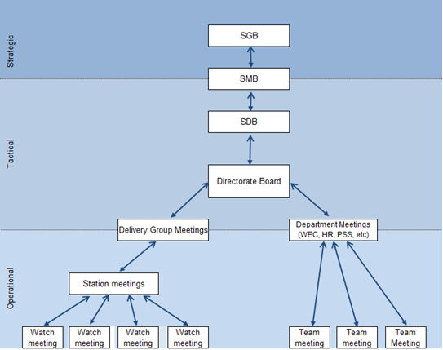
Internal Governance Arrangements
Chaired by the SCO
Routinely Attended by the SCO
Attended by the SCO as required

